Slide 1
Neutron User Facilities
24th National School on Neutron and X-Ray Scattering
August 9, 2022
Mark Lumsden

Slide 2
The first neutron source
1935 Nobel Prize in Physics for the discovery of the neutron in 1932
James Chadwick:
used Polonium as alpha emitter on Beryllium

Slide 3
Evolution of neutron sources
10²⁰
10¹⁵
Peak Thermal flux n/cm²-s
10¹⁰
10⁵
Berkeley 37-inch cyclotron
350 mCi
Ra-Be source
1
Chadwick
1930
1940
1950
1960
1970
1980
1990
2000
2010
2020
(Updated from Neutron Scattering, K. Sköld and D. L. Price, eds., Academic Press, 1986)

Slide 4
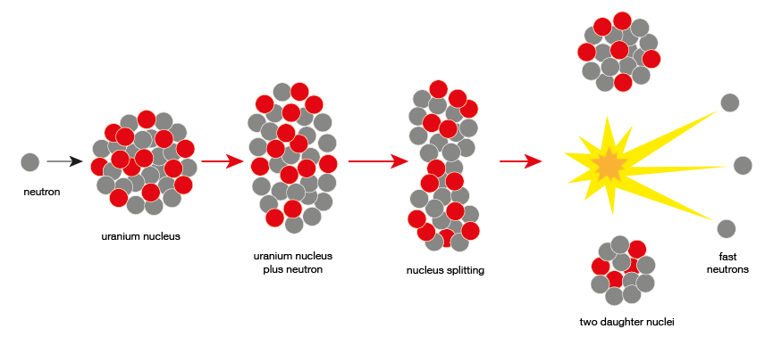
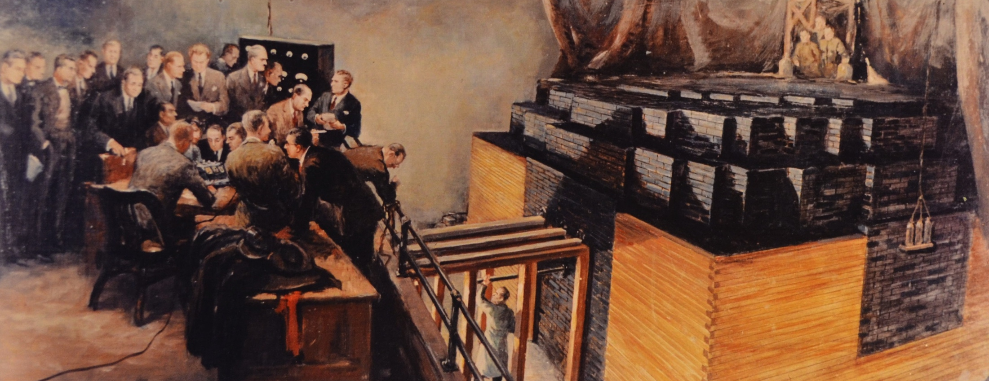
Nuclear fission
200 MeV/fission
2.35 – 1 = 1.35 excess neutrons
150 MeV/neutron
December 2, 1942

Slide 5
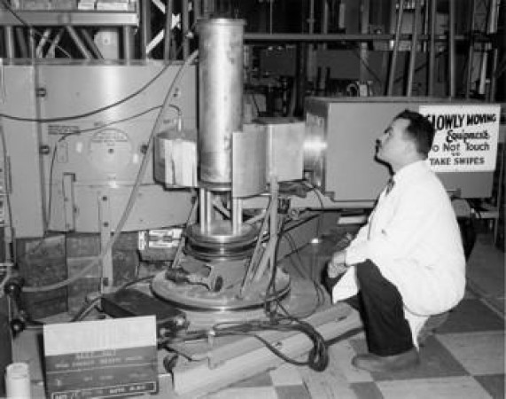
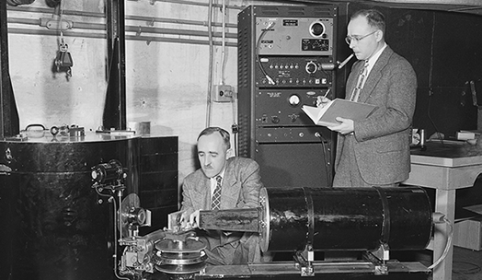
Evolution of neutron sources
10²⁰
10¹⁵
MTR
NRU
HFIR
ILL
NRX
HFBR
Peak Thermal flux n/cm²-s
X-10
10¹⁰
CP-2
CP-1
1994 Nobel Prize in Physics:
"for pioneering contributions to the development of neutron scattering techniques for studies of condensed matter"
10⁵
Berkeley 37-inch cyclotron
350 mCi
Ra-Be source
Reactor Sources
1
Chadwick
1930
1940
1950
1960
1970
1980
1990
2000
2010
2020
(Updated from Neutron Scattering, K. Sköld and D. L. Price, eds., Academic Press, 1986)

Slide 6
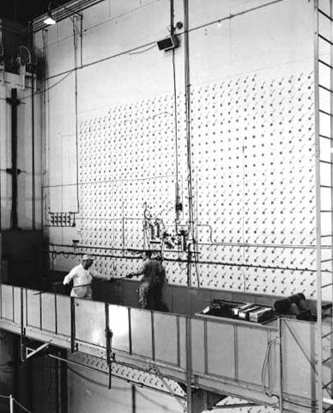
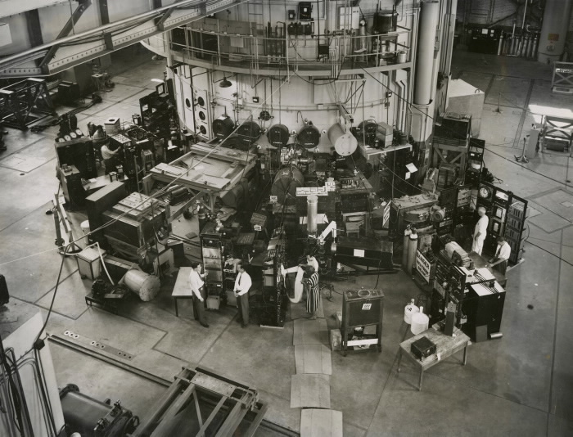
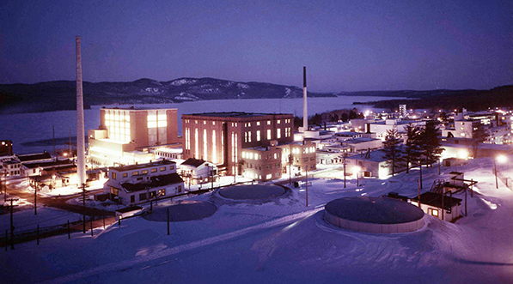
Nuclear Reactor Power Drives New Scientific Innovation
ORNL Graphite reactor
Critical on Nov. 4, 1943
Chalk River NRX Reactor
Critical on July 22, 1947
Chalk River NRU Reactor
Critical on Nov. 3, 1957
NRU
NRX
ZEEP
Original design 200 MW with natural uranium
Changed to 60 MW with high enriched Uranium
Changed to 135 MW with low enriched Uranium
Maximum power ~4 MW
maximum power 42 MW
100-200 times more neutrons than Graphite Reactor!
Notes:
ZEEP – Sept. 5, 1945

Slide 7
Evolution of neutron sources
10²⁰
10¹⁵
MTR
NRU
HFIR
ILL
NRX
HFBR
FRM-II
Peak Thermal flux n/cm²-s
X-10
10¹⁰
CP-2
CP-1
10⁵
Berkeley 37-inch cyclotron
350 mCi
Ra-Be source
Reactor Sources
1
Chadwick
1930
1940
1950
1960
1970
1980
1990
2000
2010
2020
(Updated from Neutron Scattering, K. Sköld and D. L. Price, eds., Academic Press, 1986)

Slide 8
Nuclear spallation
1 GeV proton in:
250 MeV becomes mass (endothermic reaction)
30 neutrons freed
25 MeV/neutron
6x more efficient than fission
First stage: intranuclear cascade
high-energy proton
Intermediate stage: pre-equilibrium
evaporation fission
Final stage: residual de-excitation

Slide 9
Evolution of neutron sources
10²⁰
J-PARC
ISIS
10¹⁵
MTR
NRU
HFIR
ILL
SNS
NRX
HFBR
ZING-P/
IPNS
FRM-II
Peak Thermal flux n/cm²-s
X-10
WNR
KENS
SINQ
10¹⁰
ZING-P
CP-2
CP-1
10⁵
Berkeley 37-inch cyclotron
350 mCi
Ra-Be source
Steady State Sources
Pulsed Sources
1
Chadwick
1930
1940
1950
1960
1970
1980
1990
2000
2010
2020
2040
(Updated from Neutron Scattering, K. Sköld and D. L. Price, eds., Academic Press, 1986)

Slide 10
Evolution of neutron sources
10²⁰
SNS-STS
J-PARC
SNS
ISIS
J-PARC
ESS
10¹⁵
MTR
NRU
HFIR
ILL
SNS
NRX
HFBR
ZING-P/
IPNS
FRM-II
Peak Thermal flux n/cm²-s
X-10
WNR
KENS
SINQ
10¹⁰
ZING-P
CP-2
CP-1
10⁵
Berkeley 37-inch cyclotron
350 mCi
Ra-Be source
Steady State Sources
Pulsed Sources
1
Chadwick
1930
1940
1950
1960
1970
1980
1990
2000
2010
2020
2030
2040
(Updated from Neutron Scattering, K. Sköld and D. L. Price, eds., Academic Press, 1986)

Slide 11
Evolution of neutron sources
10²⁰
SNS-STS
> $100M to build
SNS
J-PARC
ISIS
J-PARC
ESS
10¹⁵
MTR
NRU
HFIR
ILL
SNS
NRX
HFBR
ZING-P/
IPNS
FRM-II
Peak Thermal flux n/cm²-s
X-10
WNR
KENS
SINQ
10¹⁰
ZING-P
CP-2
CP-1
10⁵
Berkeley 37-inch cyclotron
350 mCi
Ra-Be source
Steady State Sources
Pulsed Sources
1
Chadwick
1930
1940
1950
1960
1970
1980
1990
2000
2010
2020
2030
2040
(Updated from Neutron Scattering, K. Sköld and D. L. Price, eds., Academic Press, 1986)

Slide 12
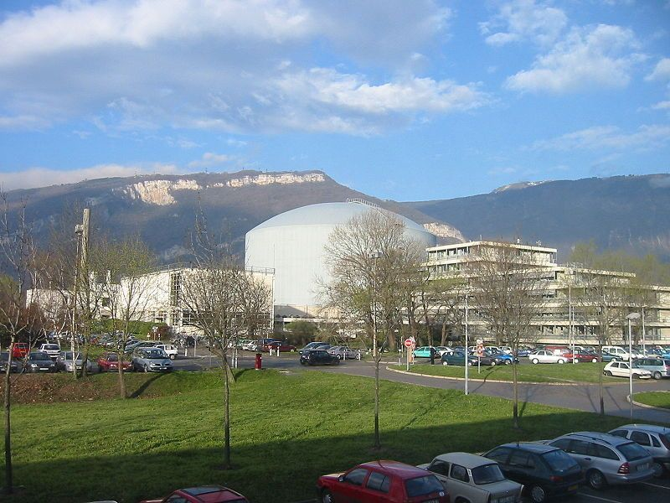
Institut Laue-Langevin (France): The First User Facility
ILL founded 1967
  First experiments 1972
  International: France, Germany, UK
A “Service Institute”
  Accessible to non-experts
  Support from an expert “local contact”
  Support for travel
  Access based on scientific merit
  Peer review of proposals
  Twice-yearly proposal rounds
Until then, large-scale facilities were mainly for in-house expert users and their collaborators

Slide 13
User Facilities
Neutrons invented user facilities
  Importance of technique
  High cost
  Small science
Now a widespread business model in science
Department of Energy Office of Science definition:
  Open to all without regard to nationality or affiliation
  Access based on merit review
  Free to use if results are to be published
  Facility allows safe and efficient work
  Facility supports user organization to represent users and promote collaboration
  Facility does not compete with private sector capability

Slide 14
Office of Science User Facilities List:
Fermi accelerator complex (FermiLab)
Argonne Leadership Computing Facility (ANL)
Advanced Light Source (LBNL)
Advanced Photon Source (ANL)
Atmospheric Radiation Measurement user facility
Accelerator Test Facility (BNL)
Argonne Tandem Linac Accelerator System (ANL)
Continuous Electron Beam Accelerator Facility (TJNAF)
Center for Functional Nanomaterials (BNL)
Center for Integrated Nanotechnologies (LANL / SNL)
Center for Nanoscale Materials (ANL)
Center for Nanophase Materials Sciences (ORNL)
DIII-D National Fusion Facility (GA)
Environmental Molecular Sciences Laboratory (PNNL)
Energy Sciences Network (LBNL)
Facility for Advanced Accelerator Experimental Tests (SLAC)
Facility for Rare Isotope Beams (Michigan State)
High Flux Isotope Reactor (ORNL)
National Synchrotron Light Source II (BNL)
Joint Genome Institute (LBNL)
Linac Coherent Light Source (SLAC)
National Energy Research Scientific Computing Center (LBNL)
National Spherical Torus Experiment (Princeton)
Oak Ridge Leadership Computing Facility (ORNL)
Relativistic Heavy Ion Collider (BNL)
Spallation Neutron Source (ORNL)
Stanford Synchrotron Radiation Light Source (SLAC)
The Molecular Foundry (LBNL)
Neutron Sources
Light Sources
Nanoscience Centers
Computing
28 Office of Science User Facilities

Slide 15
Oak Ridge National Laboratory User Facilities
Building Technologies Research and Integration Center
Manufacturing
Demonstration Facility
Carbon Fiber
Technology Facility
National Transportation Research Center
ORNL user
facilities
Center for Nanophase Materials Sciences
Spallation Neutron Source
High Flux
Isotope Reactor
Oak Ridge Leadership Computing Facility
Center for Structural
Molecular Biology
Notes:
SC designated user facilities: CNMS, HFIR, SNS, and OLCF.
EERE “shared R&D facilities” (per DOE Office of Technology Transitions): BTRIC, CFTF, MDF, and NTRC
Center for Structural Molecular Biology (BER-sponsored beamline at HFIR);
NOT SHOWN HERE:
DOE-NE Nuclear Science User Facilities (NSUF) facilities: HFIR, Irradiated Fuels Examination Laboratory (IFEL), Irradiated Materials Examination and Testing Facility (IMET), Low Activation Materials Design and Analysis Laboratory (LAMDA)
Also on OTT list of “Shared R&D Facilities”:
SPRUCE field research site; High Temperature Materials Laboratory; Oak Ridge National Environmental Research Park; Safeguards Laboratory; Radiochemical Engingering Development Center

Slide 16
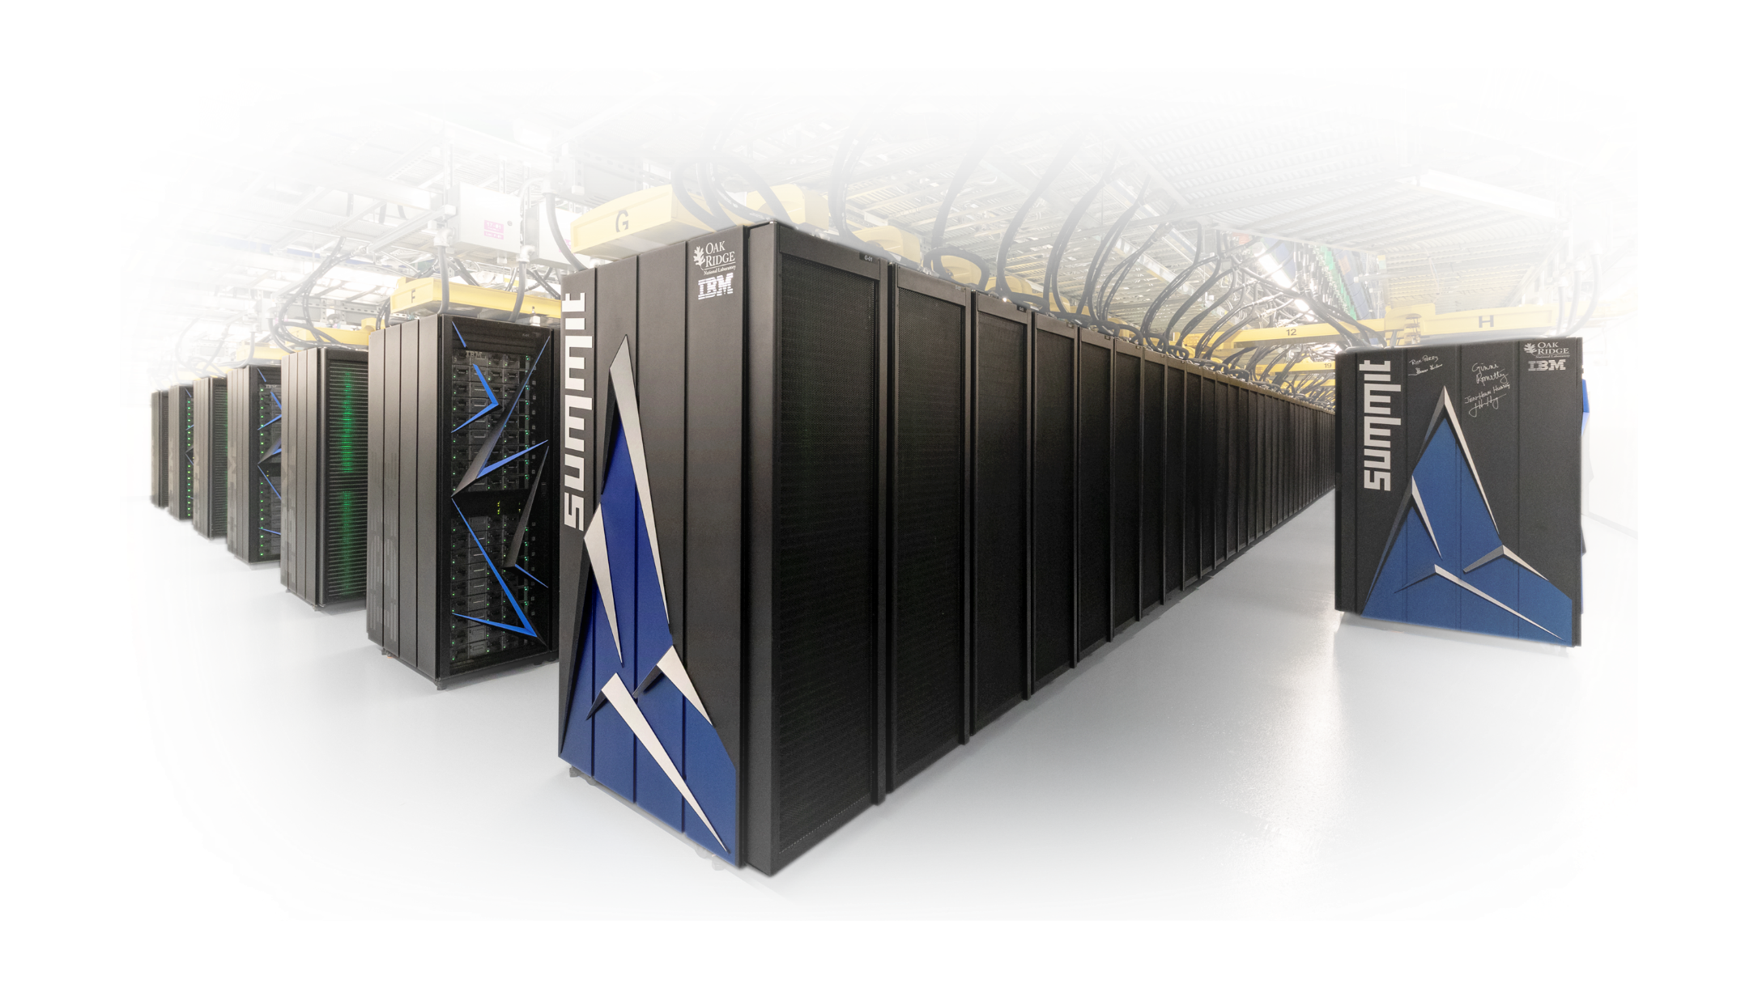
Oak Ridge Leadership Computing Facility
Computing and Computational Sciences Directorate (CCSD) houses the Oak Ridge Leadership Computing Facility, home to Summit and now Frontier
Provides expertise in data science, modeling and simulation for grand challenge science
Advances the state-of-the-art in artificial intelligence, data science and quantum information science
Access to OLCF resources is limited to approved projects and their users through user proposals and depends on the scientific merit, suitability and appropriateness of work to DOE objectives.
Notes:
Objective for this slide: Who we are and where we’re going.
The vision/strategy was created by the ALDs in June/July – please use that and capture the essence of your culture.
Summit
Summit is the next leap in leadership-class computing systems for open science. With Summit we will be able to address, with greater complexity and higher fidelity, questions concerning who we are, our place on earth, and in our universe.
Summit, launched in 2018, delivers 8 times the computational performance of Titan’s 18,688 nodes, using only 4,608 nodes. Like Titan, Summit has a hybrid architecture, and each node contains multiple IBM POWER9 CPUs and NVIDIA Volta GPUs all connected together with NVIDIA’s high-speed NVLink. Each node has over half a terabyte of coherent memory (high bandwidth memory + DDR4) addressable by all CPUs and GPUs plus 800GB of non-volatile RAM that can be used as a burst buffer or as extended memory. To provide a high rate of I/O throughput, the nodes are connected in a non-blocking fat-tree using a dual-rail Mellanox EDR InfiniBand interconnect.

Slide 17
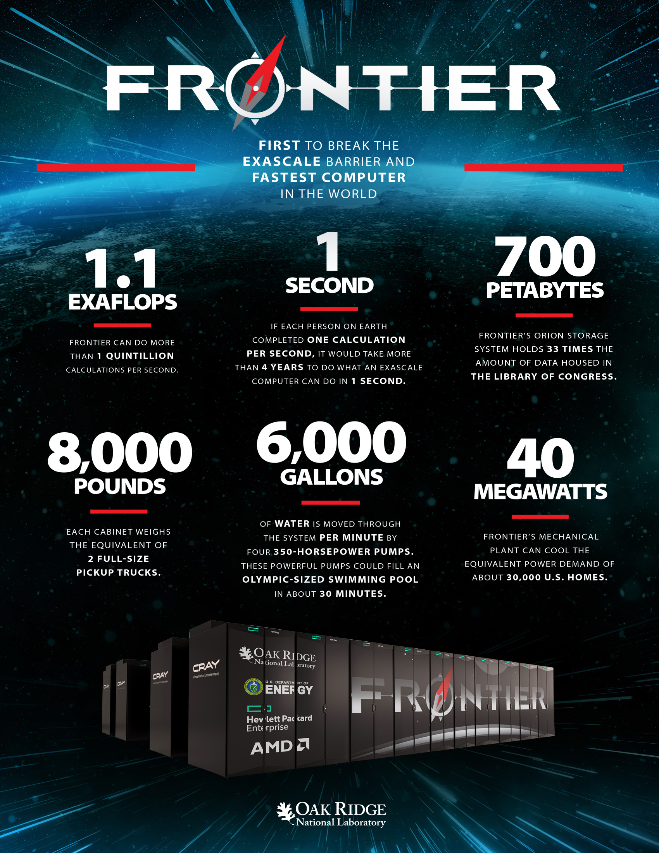
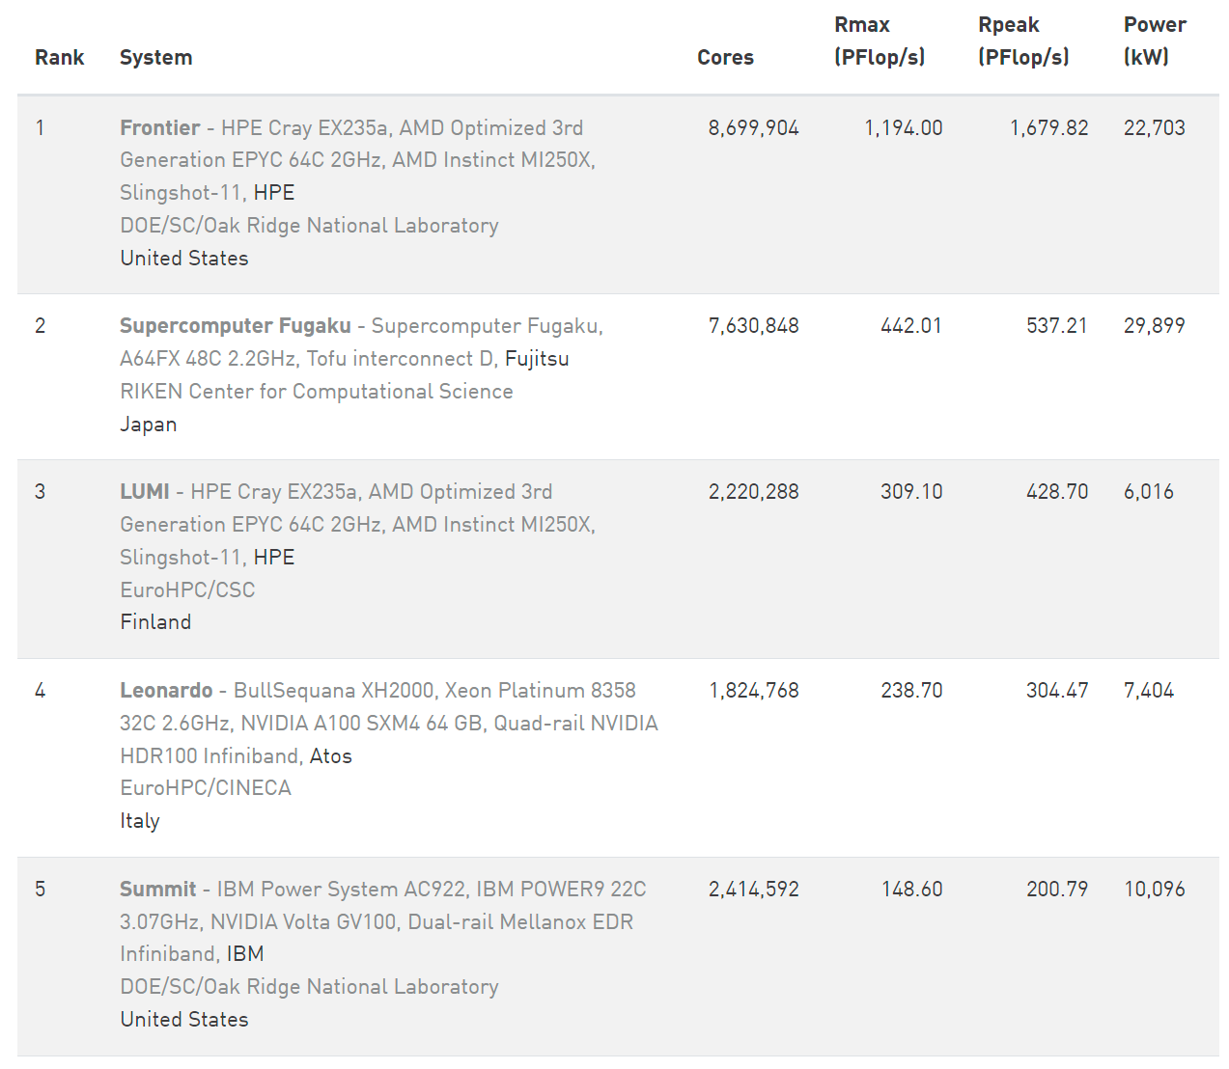
May 30, 2022

Slide 18
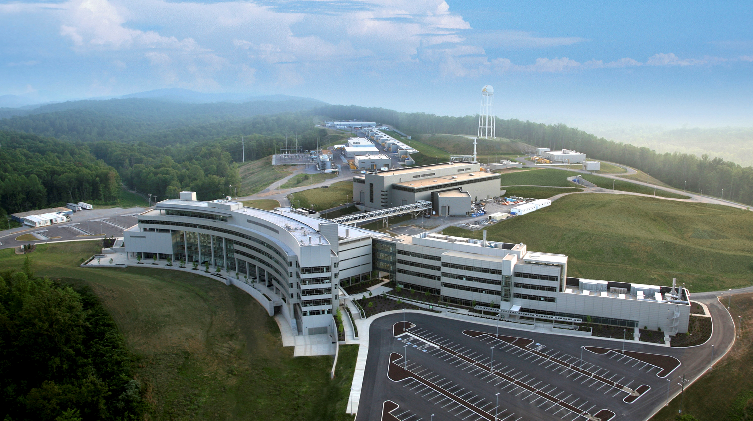
Center for Nanophase Materials Sciences
A user facility for nanoscale and quantum materials
The Center for Nanophase Materials Sciences (CNMS) at ORNL offers the user community access to state-of-the-art equipment for a broad range of nanoscience research, including nanomaterials synthesis, nanofabrication, imaging/ microscopy/characterization, and theory/modeling/simulation.
Access is obtained through a peer-reviewed proposal with no charge for users who intend to publish their results in the open literature.
CNMS also acts as gateway for the nanoscience community to benefit from ORNL’s neutron sources (SNS and HFIR) and computational resources.
Broad spectrum of imaging capabilities
  scanning transmission electron microscopy emphasizing electron energy loss spectroscopy
  scanning probe microscopies
  He-ion microscopy
  atom probe tomography
  mass spectrometry-based chemical imaging
Notes:
Notes needed for CNMS and CSMB

Slide 19
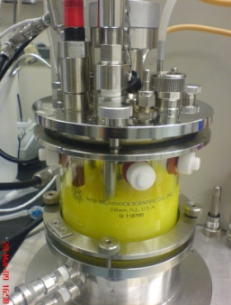
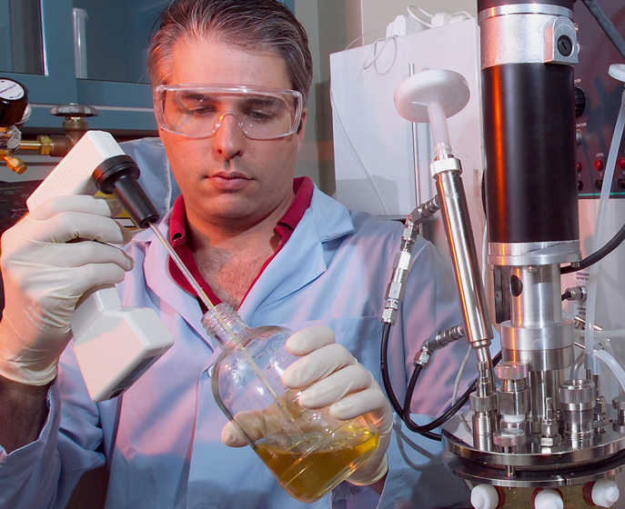
Center for Structural Molecular Biology
Deuteration access through SNS/HFIR User Program
The Center for Structural Molecular Biology (CSMB) at ORNL is an open access user program dedicated to advancing instrumentation and methods for determining the three-dimensional structures of biomacromolecules and their assemblies as well as hierarchical structures and biomimetic systems.
The centerpiece of the CSMB is a SANS instrument at HFIR dedicated to studying biological samples (Bio-SANS).
CSMB also operates a Bio-Deuteration Laboratory for cloning, protein expression, purification, and characterization of H/D-labeled biological macromolecules. When deuterium labeling is combined with SANS experimentation, data analysis and visualization, models of complex systems can be constructed that are not obtainable using other techniques.
Biological H/D labeling of cells, proteins, nucleic acids, lipids, uniform, selective labeling
Biomolecule purification and characterization
Chemical deuteration in collaboration with the CNMS
Supporting capabilities: protein crystallography, SAXS

Slide 20
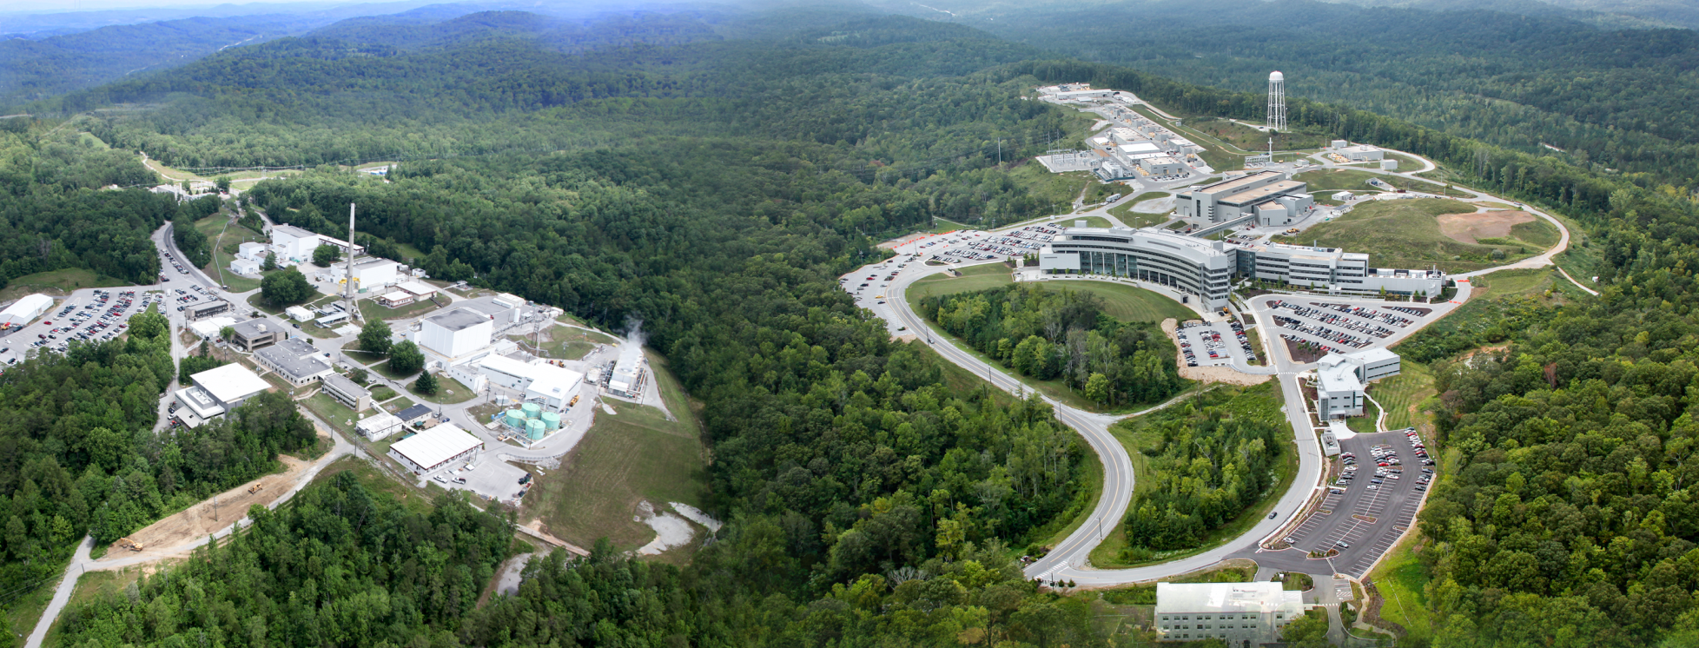
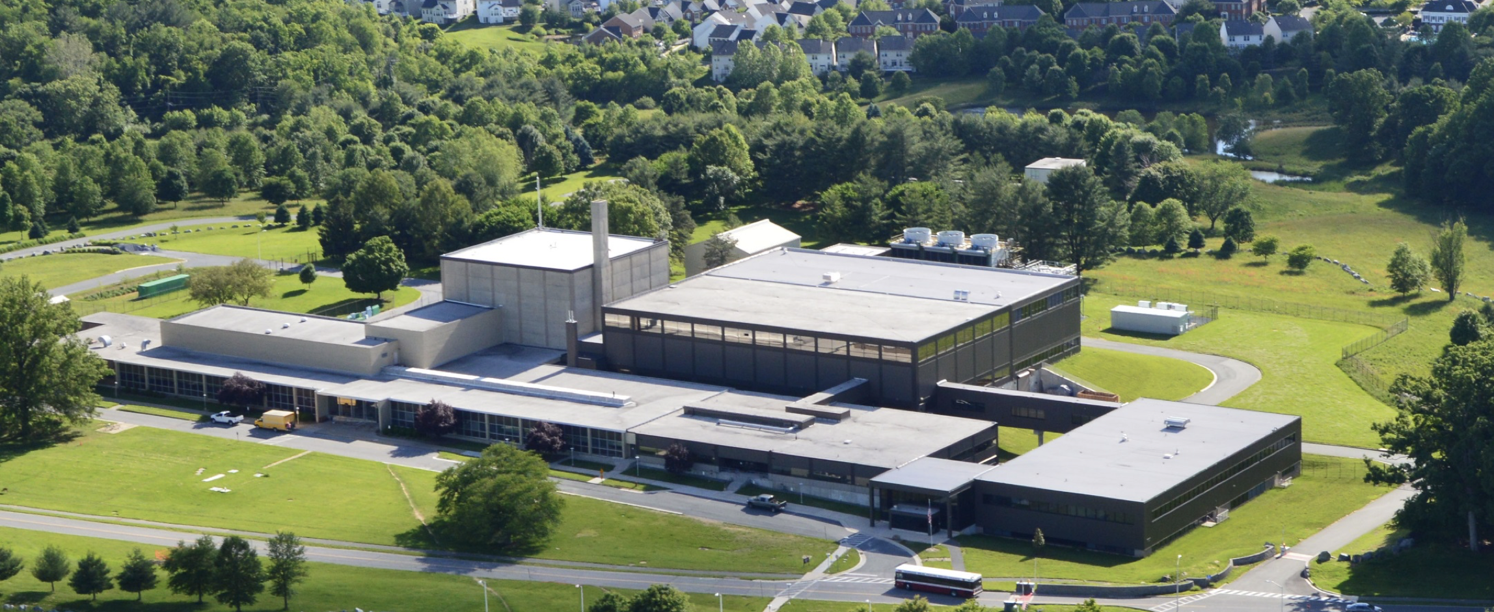
Neutron User Facilities in North America
High Flux Isotope Reactor (HFIR)
Operating at 85 MW, HFIR provides one of the highest steady-state neutron fluxes of any reactor in the world for materials research.
12 Instruments in the user program
Spallation Neutron Source (SNS)
SNS is the most powerful pulsed neutron source in the world for materials research
18 Instruments in user program
HFIR
SNS
NIST Center for Neutron Research
NCNR
20 MW reactor in Gaithersburg, MD
13 Instruments in user program.

Slide 21
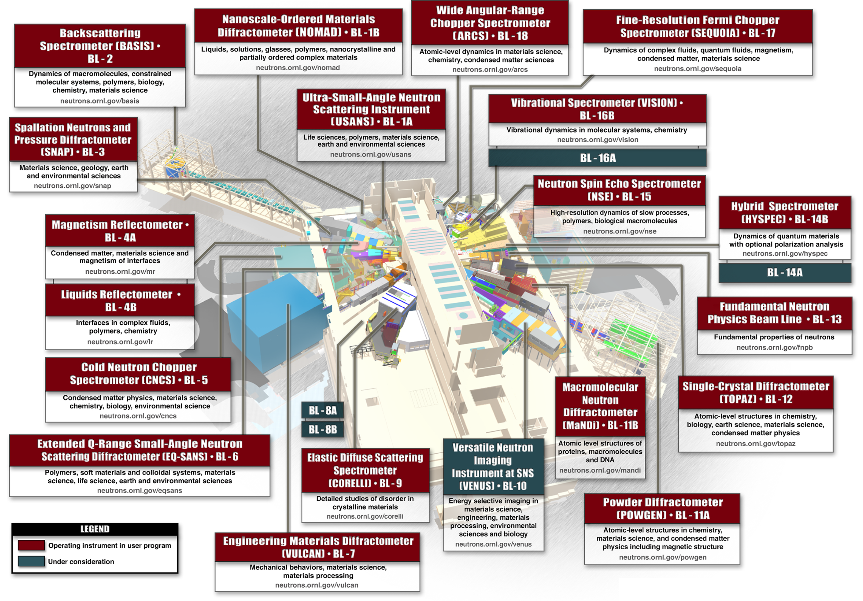
Spallation Neutron Source
18 instruments in user program
  Diffraction
  Spectroscopy
  Engineering
  SANS & reflectrometry
1 not in user program
  Fundamental physics
1 instrument in construction
4 available instrument slots

Slide 22
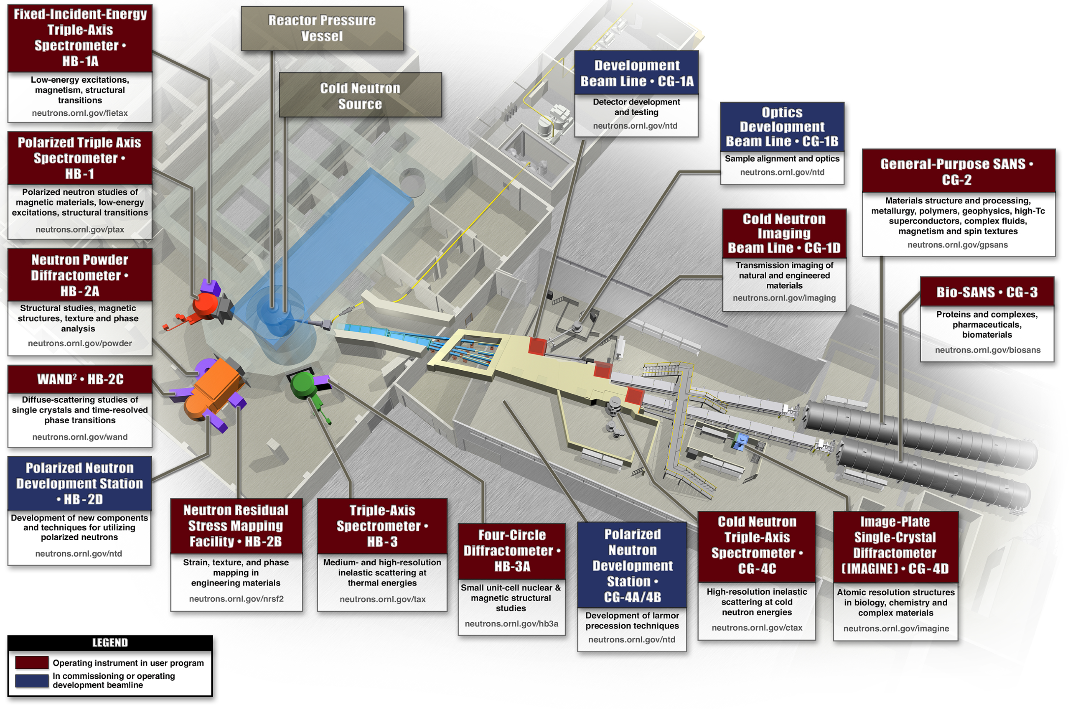
High Flux Isotope Reactor
12 instruments in user program
  Diffraction
  Spectroscopy
  Engineering
  Imaging
  SANS
4 development beamlines
Non-beam program
  Isotope production
  Irradiation facilities
  Activation analysis
  Fundamental physics

Slide 23
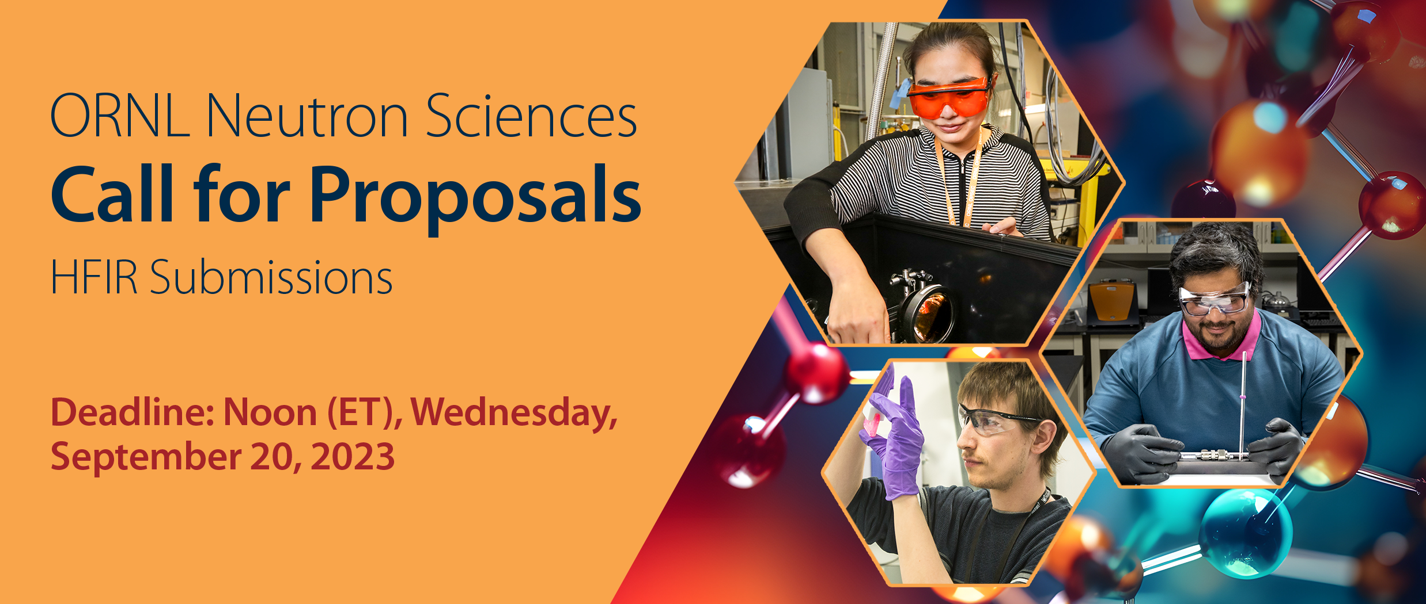
Becoming a neutron scattering user at SNS or HFIR
Prospective users should submit a proposal to one of our biannual proposal calls
2024-A GU proposal call for HFIR submissions only is open now and will close on Sept. 20, 2023.
1500+ General User proposals requesting beam time are received annually
New users should contact an instrument scientist for feedback on their experimental plan before submitting
More information and tips on submitting a proposal can be found at https://neutrons.ornl.gov/users

Slide 24
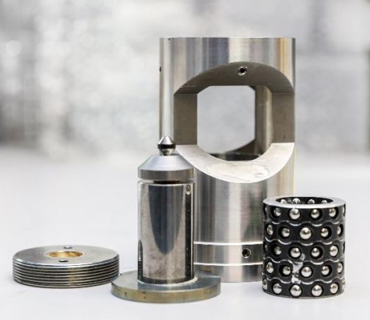
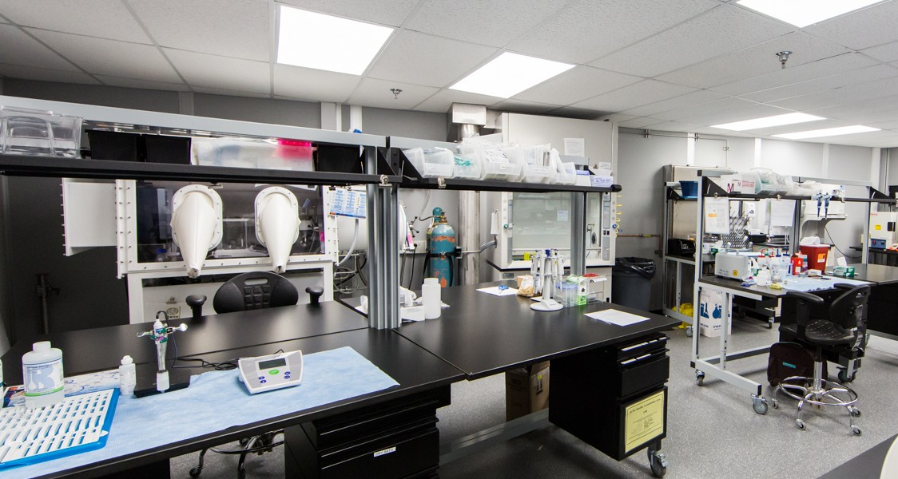
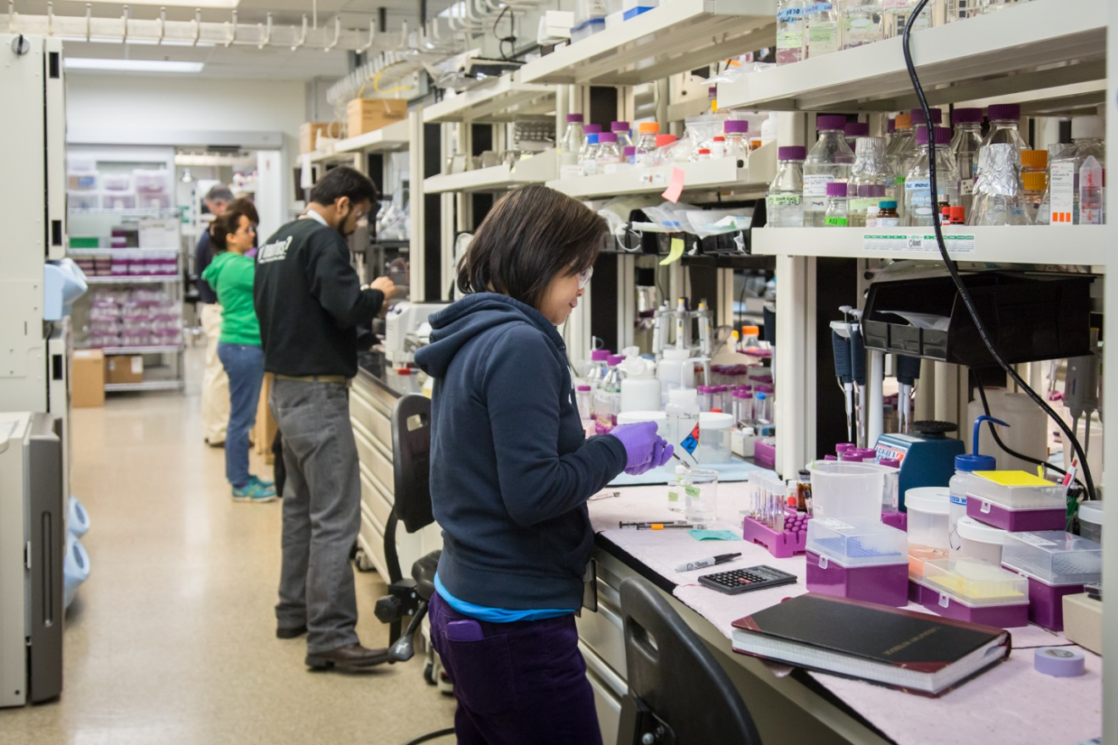
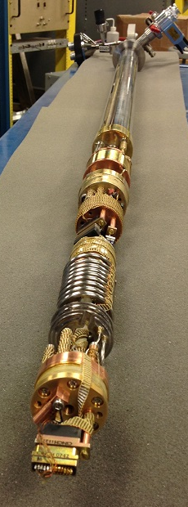
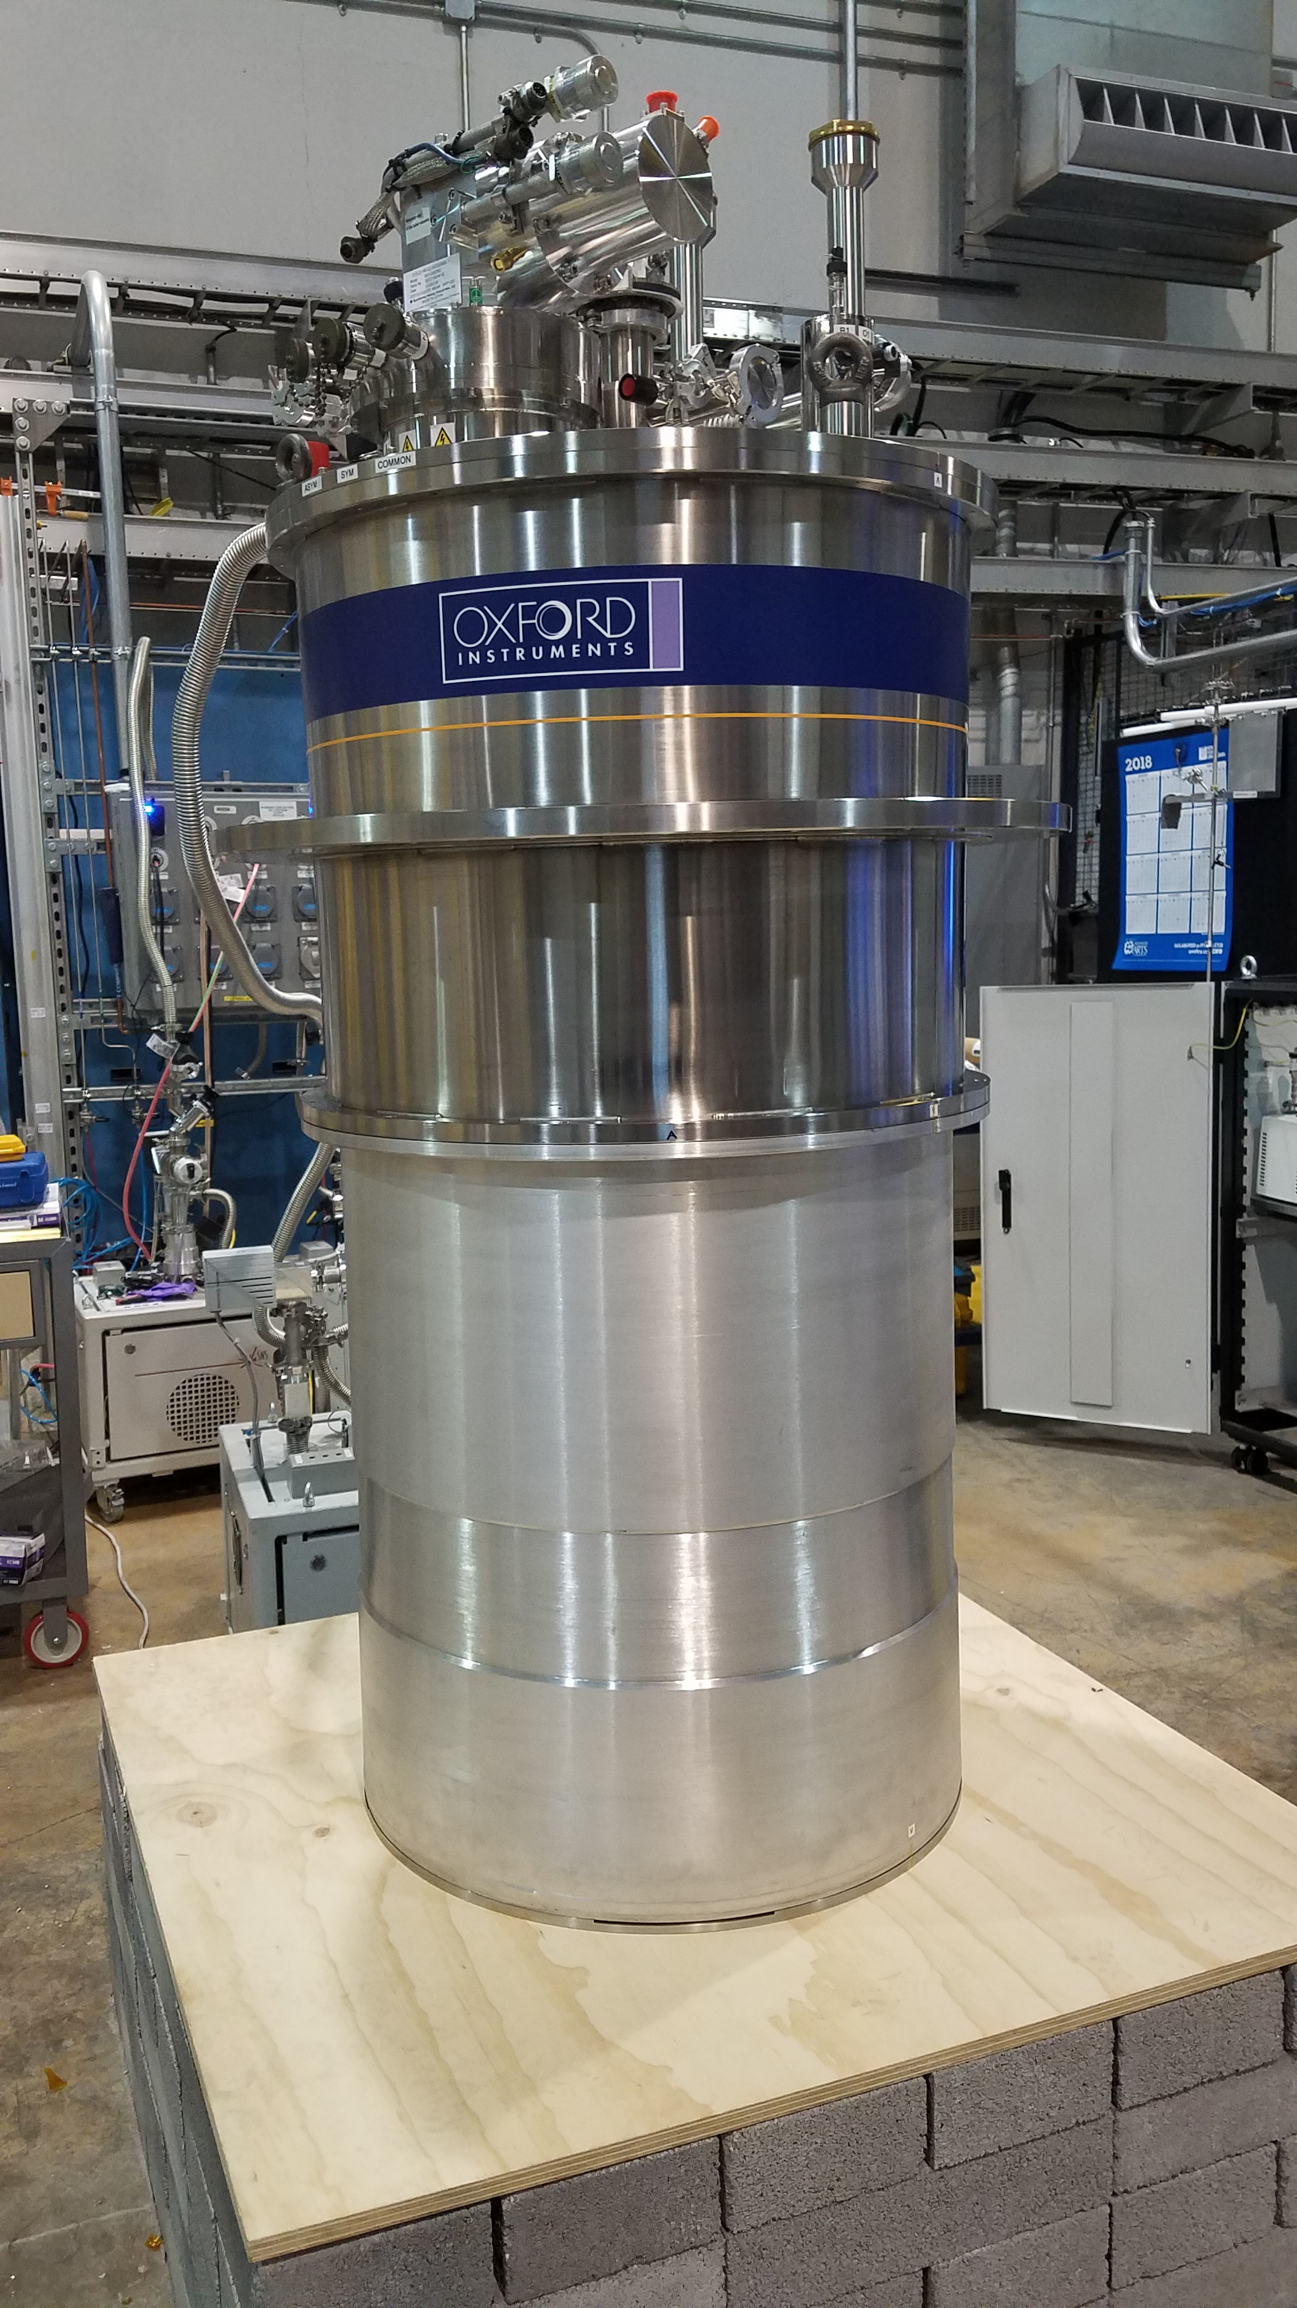
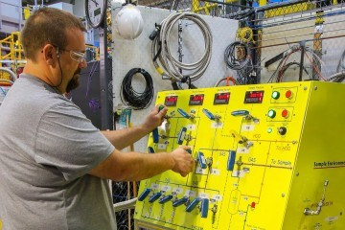
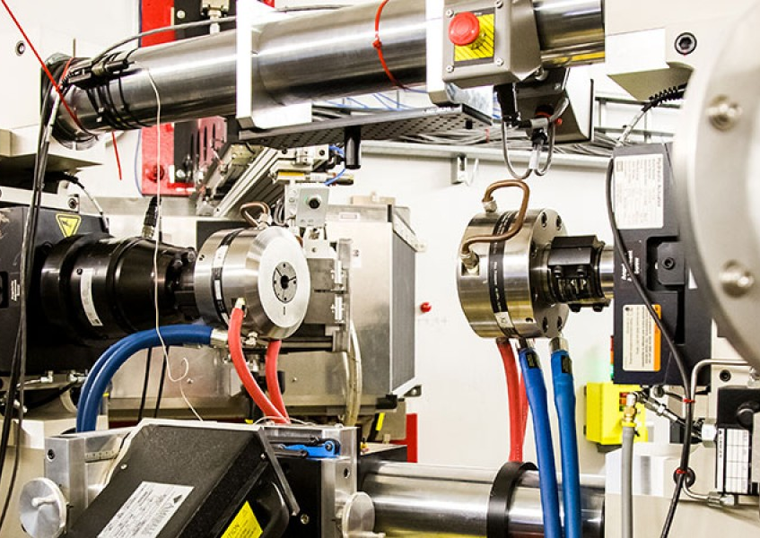
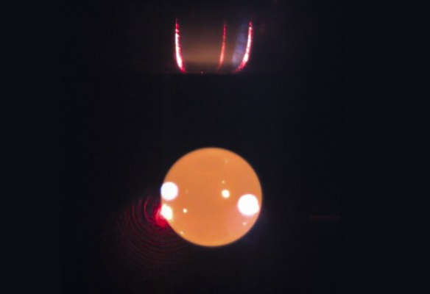
Sample Environment and Complementary Facilities
Experiments are increasingly complex – few ‘routine’ measurements
Complementary laboratory facilities are needed for sample preparation (including deuteration) and characterization

Slide 25
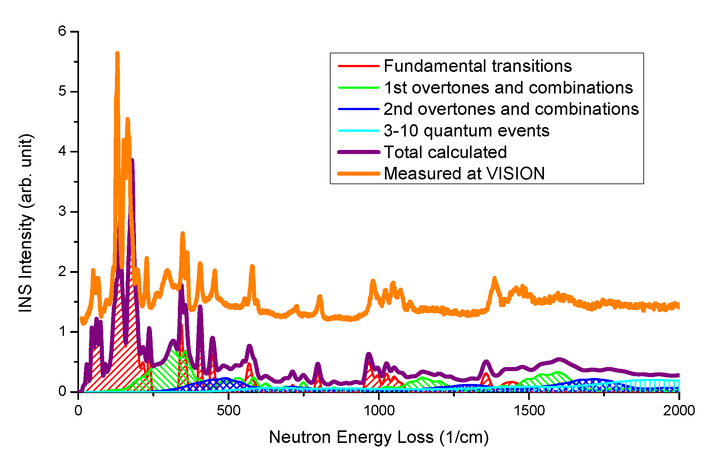
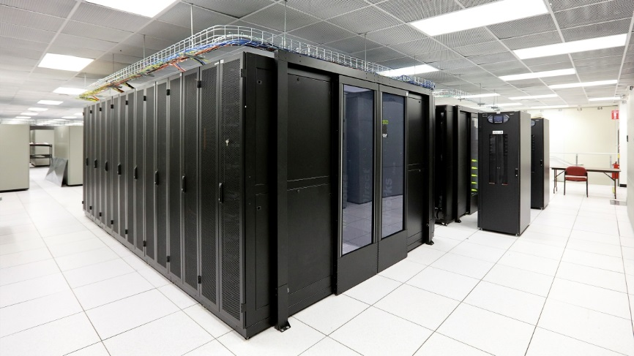
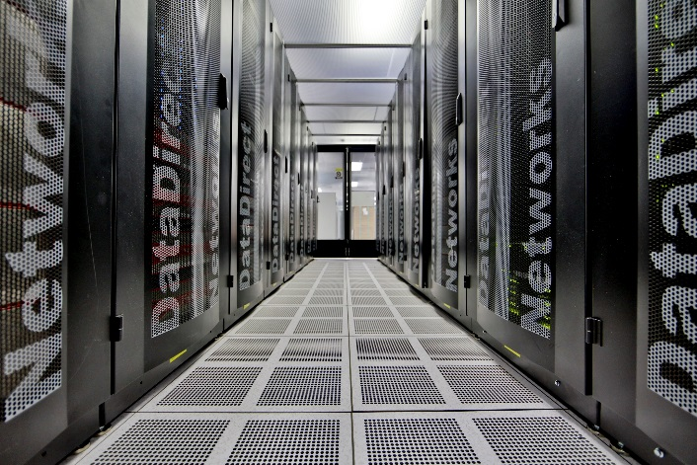
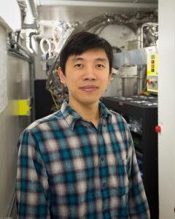
Integrated Modeling (VISION)
OCLIMAX
(YQ Cheng, Timmy Ramirez-Cuesta)
Inelastic neutron scattering calculation for both powders and single crystals using DFT
Computer modeling is crucial to understand and interpret INS data.
INSPIRED: Inelastic Neutron Scattering Prediction for Instantaneous Results and Experimental Design
VirtuES cluster
DFT + OCLIMAX used to simulate lattice dynamics and make a database of simulated spectra (>10k inorganic crystals and >20k organic molecules.
Machine learning prediction of INS from structure
YQ Cheng

Slide 26
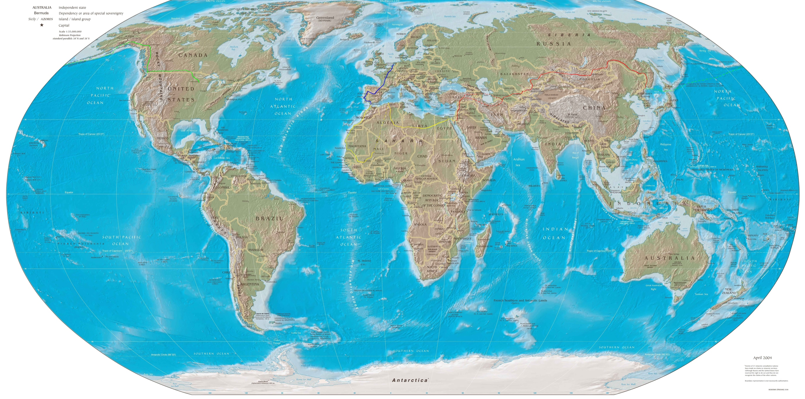
Neutron User Facilities Worldwide
ESS
PNPI
ISIS
HZB
Dubna
NRU
MLZ
LLB
ILL
PSI
CARR
J-PARC
HFIR
NIST
LANSCE
STS
SNS
Hanaro
JRR-3
CMRR
Dhruva
CSNS
SAFARI
ANSTO
Bariloche
RA10
operational
shut down recently
coming soon

Slide 27
Neutron Facilities Worldwide

Slide 28

Neutron Facility Ecosystem

Slide 29
Neutron Facility Ecosystem
2018
world-leading
ILL
ISIS
SNS
J-PARC
regional/national
Europe
North America
Asia
Others
MLZ
NIST
ANSTO
PSI
HFIR
CSNS
high-flux & medium-flux scattering facilities
LLB
HZB
JRR-3
NRU
Dhruva
BNC
Missouri
MNR
KURRI
Bariloche
Kjeller
low-flux & compact sources
SAFARI
Delft
LENS
MITR
HUNS

Slide 30
Neutron Facility Ecosystem
2023
Plenty of action here: STS, ESS, …
world-leading
ILL
ISIS
SNS
J-PARC
regional/national
Europe
North America
Asia
Others
ANSTO
How do we keep this level healthy?
MLZ
PSI
NIST
HFIR
✗
CSNS
high-flux & medium-flux scattering facilities
LLB
✗
✗
JRR-3
HZB
NRU
Dhruva
BNC
✗
Missouri
MNR
Bariloche
Kjeller
KURRI
low-flux & compact sources
This needs to be boosted!
Delft
LENS
MITR
HUNS
SAFARI

Slide 31
Approaches for future neutron sources
Replacement/upgraded research reactors
  Doable in North & South America, Africa, Asia (partly)
  Not doable in Europe
Pulsed Spallation Sources
  High neutron yield
  High cost of shielding (particles with energies up to proton energy)
  Way to go for high-end sources
Low-energy accelerator-based sources
  Cheaper proton accelerator (below spallation threshold)
  Intrinsically lower neutron yield
  Much cheaper to shield (fewer high-energy particles)
  Actively pursued in Europe (Germany, France, Spain) and Canada

Slide 32
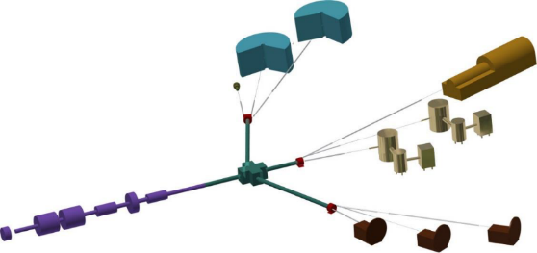
“Compact” Neutron Sources
Pulsed proton accelerator
  Low energy: 2-70 MeV (~1GeV for spallation)
  1-4% duty cycle
  Beam power 1-100 kW
  Well-suited to multiple target stations
  Scaleable
Jülich High Brilliance Source
SNS: 1.4 MW
~10¹⁷ n/s

Slide 33
“Compact” Neutron Sources
Lower-flux facilities are often not user facilities
  Lower throughput: access through collaboration
  Develop expert users
  In-house groups develop new techniques
  Train neutron specialists & users

Slide 34
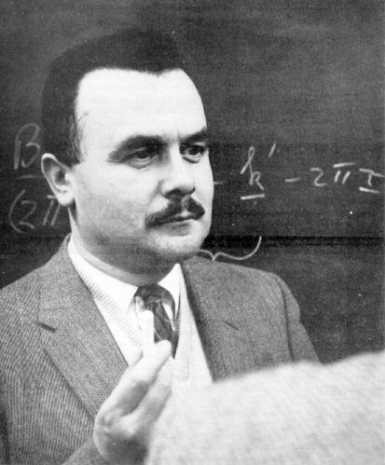
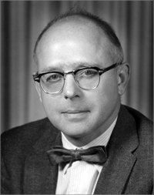
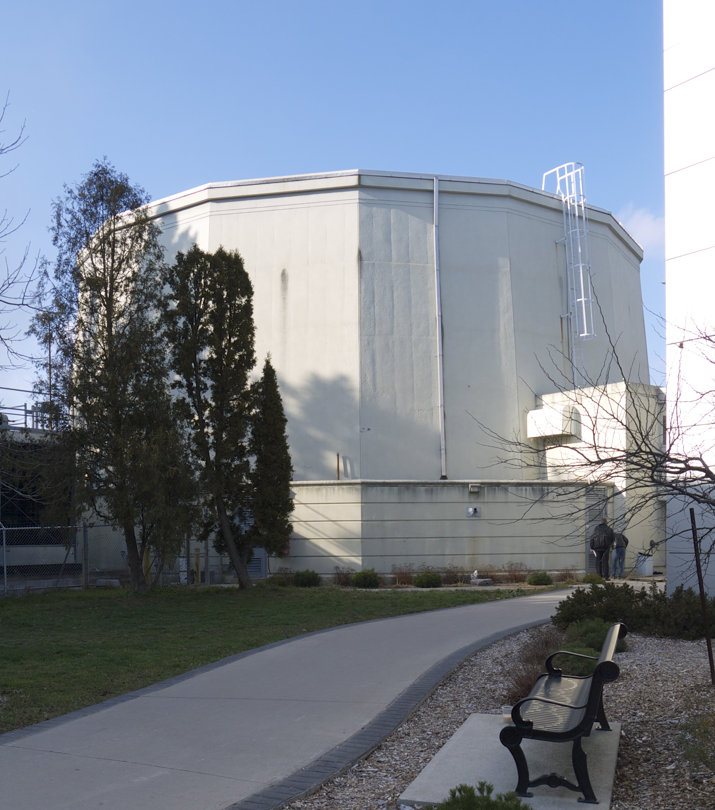
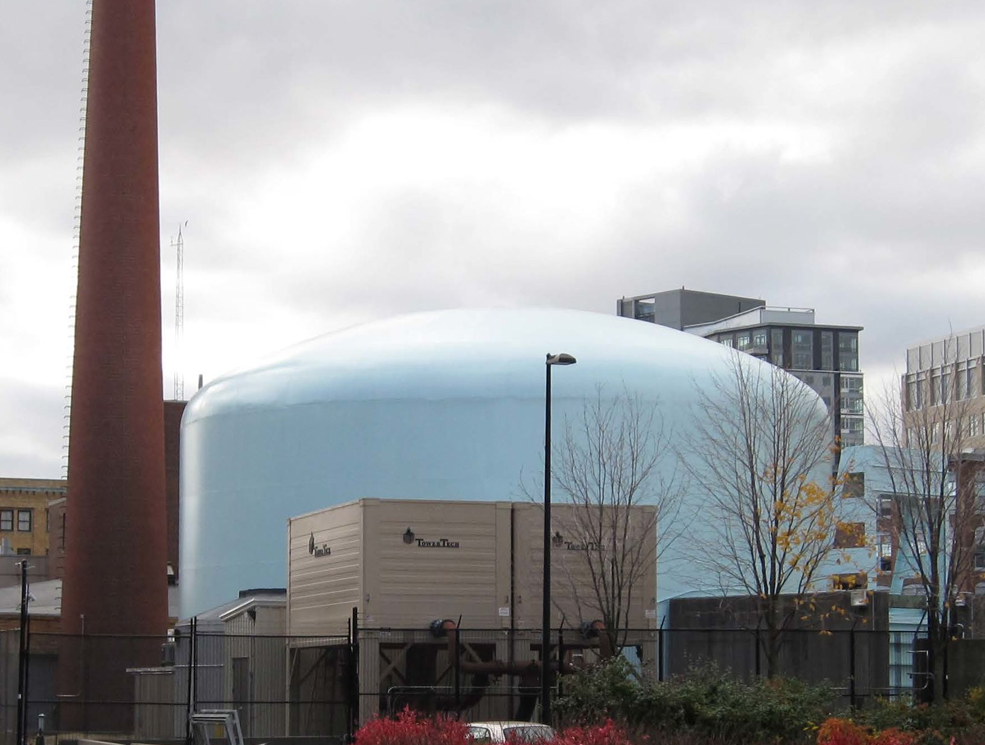
Students – essential in growing the user community and training next generation neutron scientists.
- Brockhouse and Shull recognized this!
Chalk River Laboratories
Oak Ridge National Laboratory
Bert Brockhouse
Cliff Shull
McMaster University (1962)
MIT (1955)
MIT Nuclear Research Reactor
(5 MW 1958-1974
6 MW 1974 – present)
McMaster Nuclear Reactor
(5 MW - 1959)

Slide 35
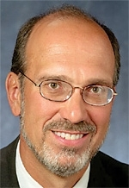
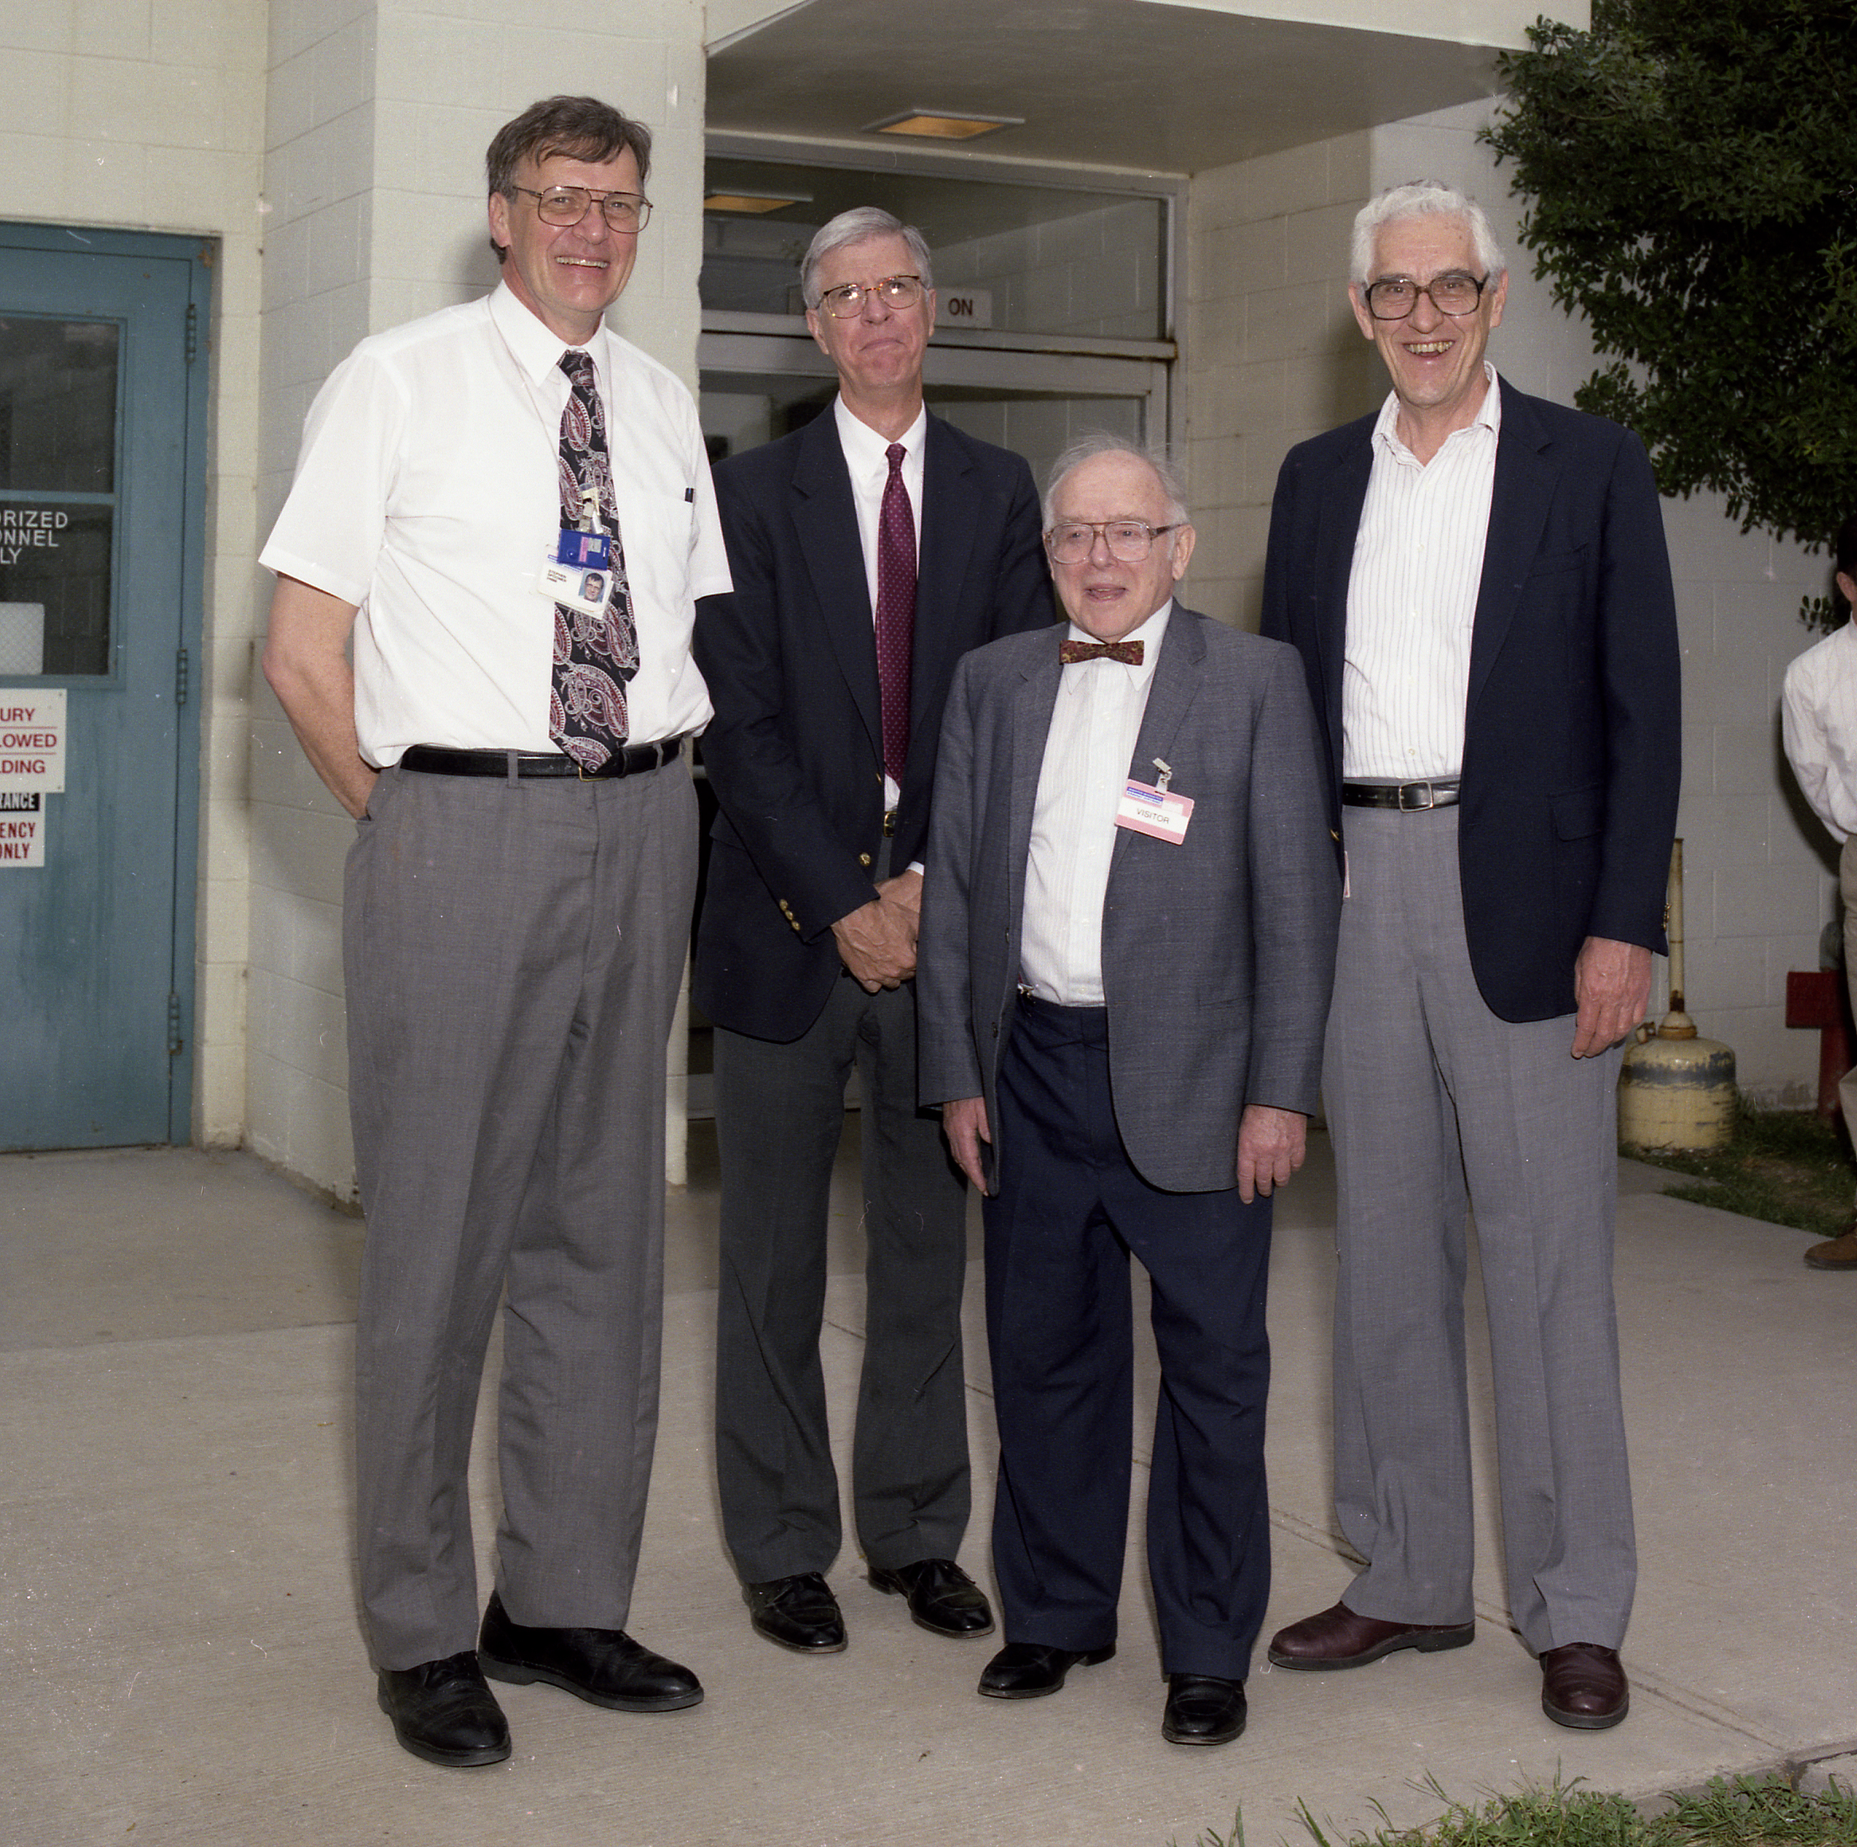
Legacy of training students
Students of Bertram Brockhouse
Students of Clifford Shull
Eric Svensson
Chalk River – pioneering work on liquid He
Herb Mook
Pioneering work on superconductors and metals. Former director of neutron scattering at HFIR
Bill Kamitakahara
Developed the NCNR user program
David Moncton Former director of APS and the SNS project
Ralph Moon
Development of neutron polarization analysis. Former director of neutron scattering at HFIR
Sow-Hsin Chen Professor MIT
Brockhouse
John Copley
Built DCS spectrometer at NCNR
Michael Rowe
Director of NIST Center for Neutron Research
Shull
Stephen Spooner
HFIR – materials science and residual stress

Slide 36
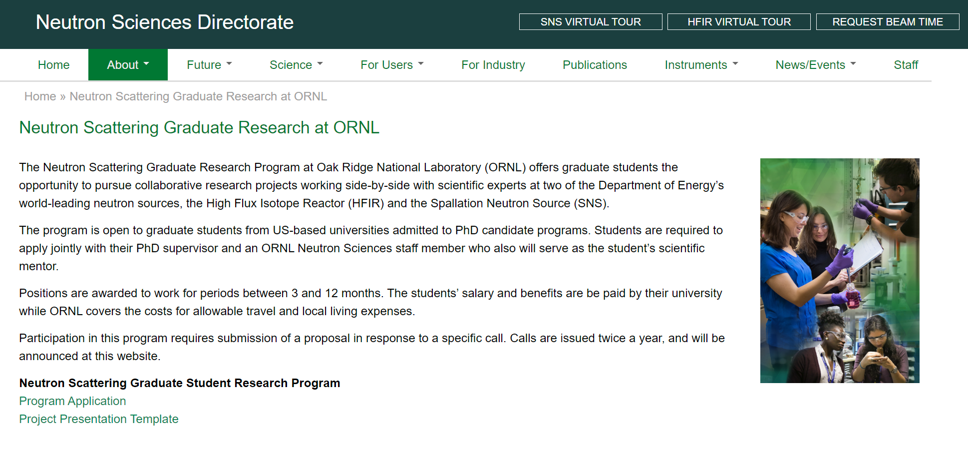

Graduate Student Opportunities at SNS / HFIR!
https://neutrons.ornl.gov/neutron-scattering-graduate-program

Slide 37
Bottom Line
Neutron scattering invented the User Facility
  Effective and efficient means of providing access to large and diverse user community
  Access to facilities which are scientifically essential, but unaffordable to university groups or industry
We’re still reinventing it
  Couple beamtime access with ancillary capabilities: deuteration, sample environment, advanced data analysis approaches, …
Neutron science relies on healthy ecosystem of neutron facilities
  High-end user facilities
  Medium-flux hybrid user facilities
  Compact facilities doing collaborative science
Students are critical to the growth of the neutron user community

Slide 38
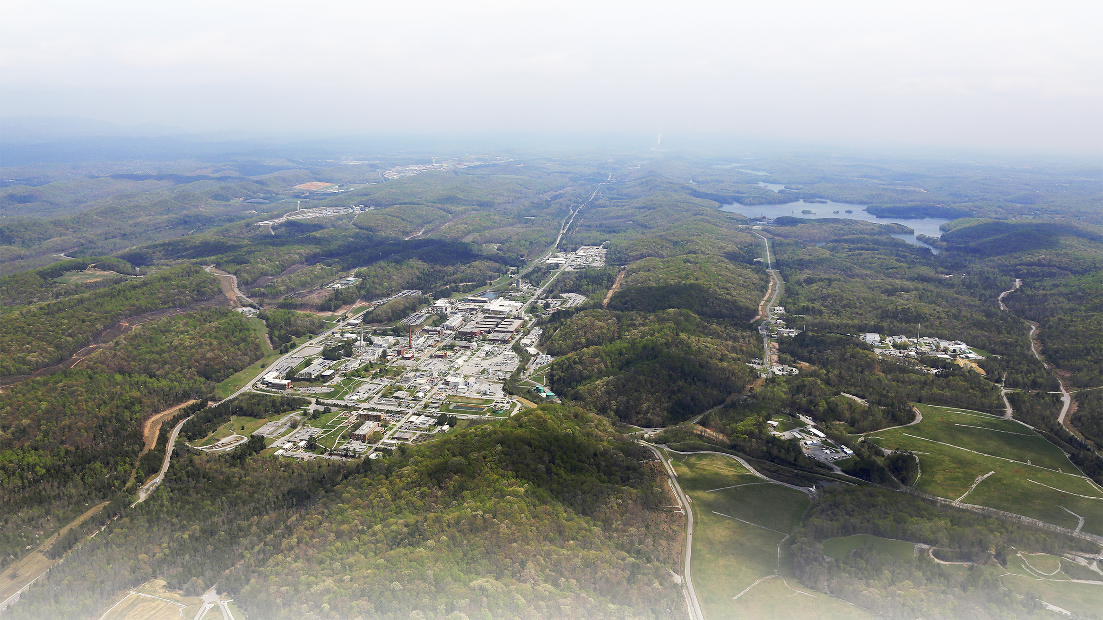
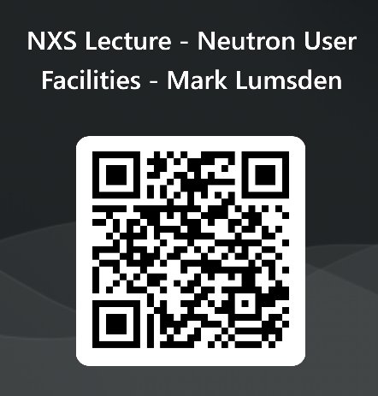
Thank you!

Slide 39
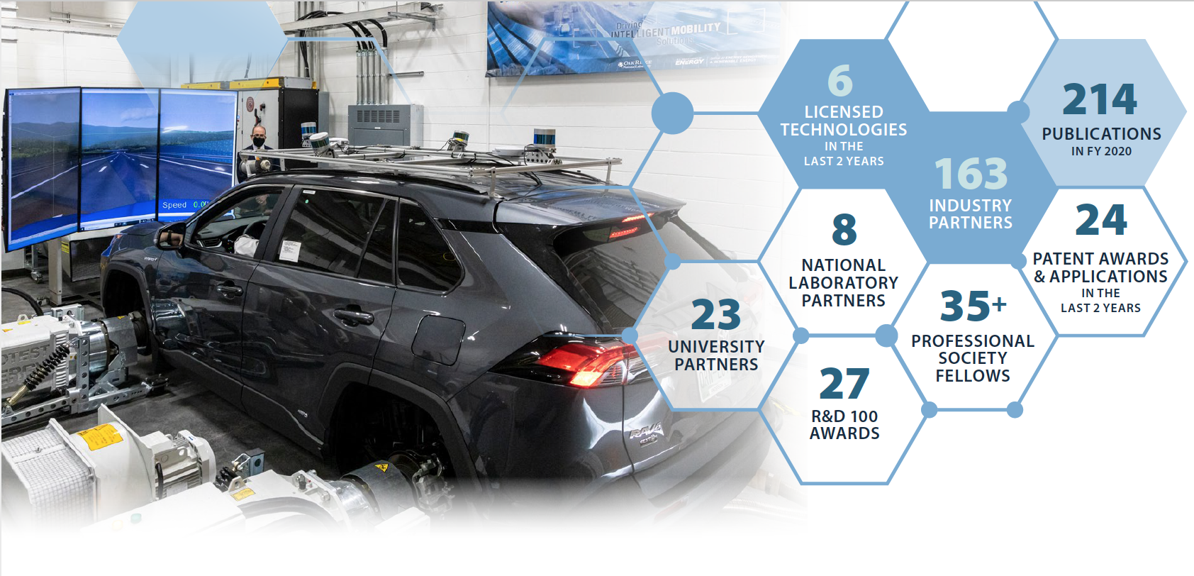
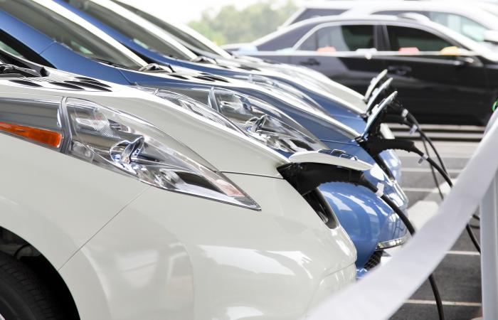
National Transportation Research Center
The National Transportation Research Center (NTRC), established in 2000, is the Department of Energy’s only designated user facility focused on performing early-stage research and development in transportation technologies.
Research focuses on advanced energy storage and electric drive systems, including fast wired and wireless charging; lightweight materials and multi-material structures for harsh environments; advanced combustion engines and alternative biofuels; data science, analysis, and vehicle cybersecurity; vehicle systems integration; intelligent mobility systems.
The NTRC comprises a 65,000 sq. ft. facility that integrates capabilities, from novel diagnostics to component and vehicle evaluation to data analytics and cybersecurity.
The facility is dedicated to accelerating the pace of research and development for new materials in next-generation systems, providing decision making tools for sustainable transportation systems, and creating economic opportunity by improving the energy efficiency of vehicles to support a robust transportation system for people and commerce.

