Slide 1
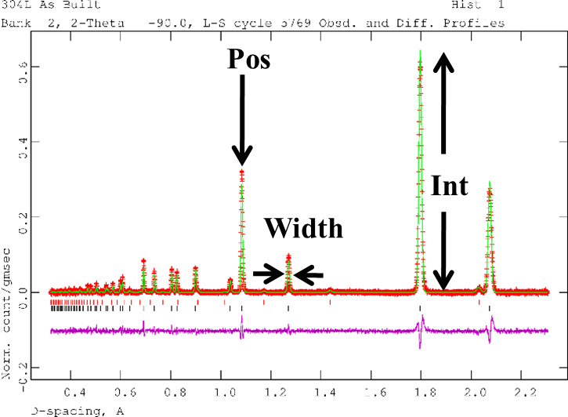
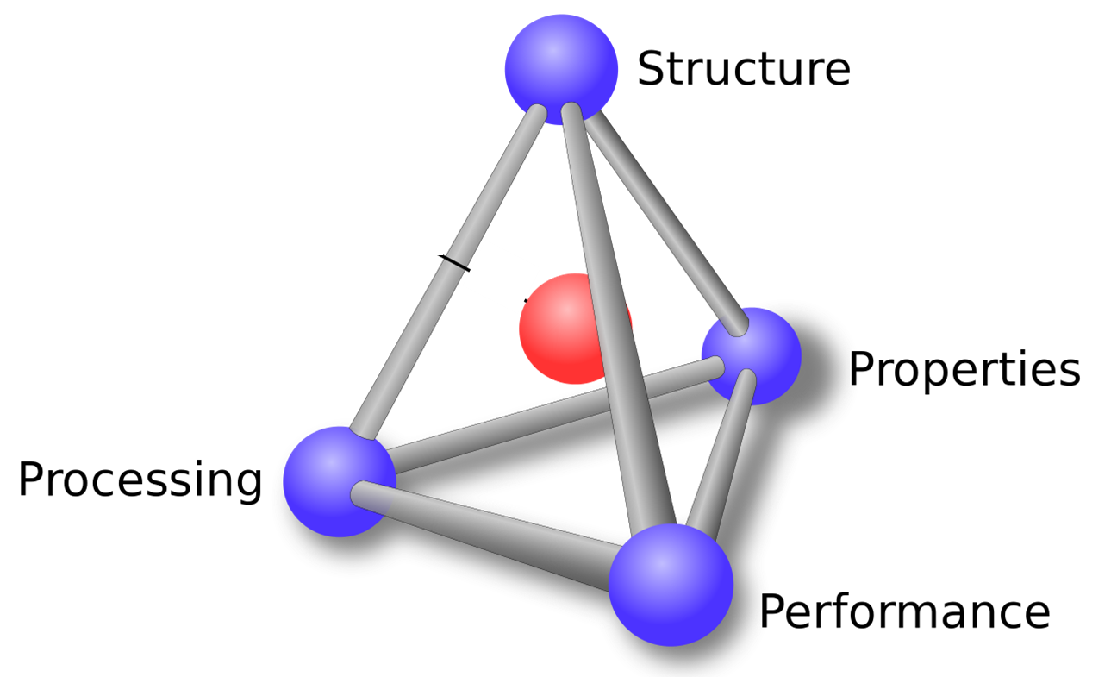
Using Diffraction to Make the Connection Between Materials Processing and Properties
Donald W. Brown
Los Alamos National Laboratory, Los Alamos, NM 87544

Slide 2

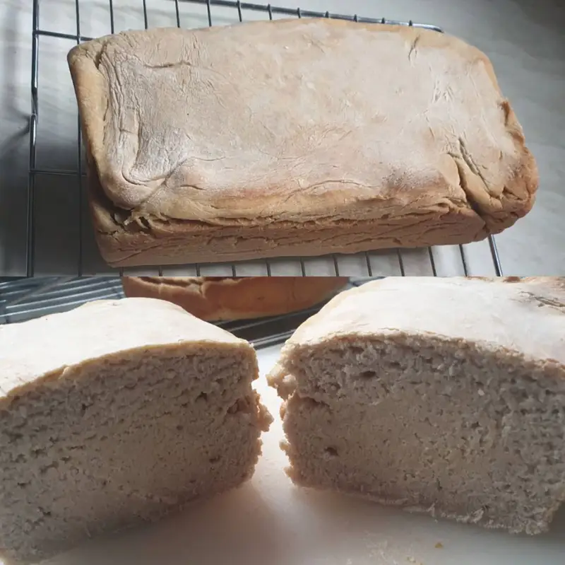
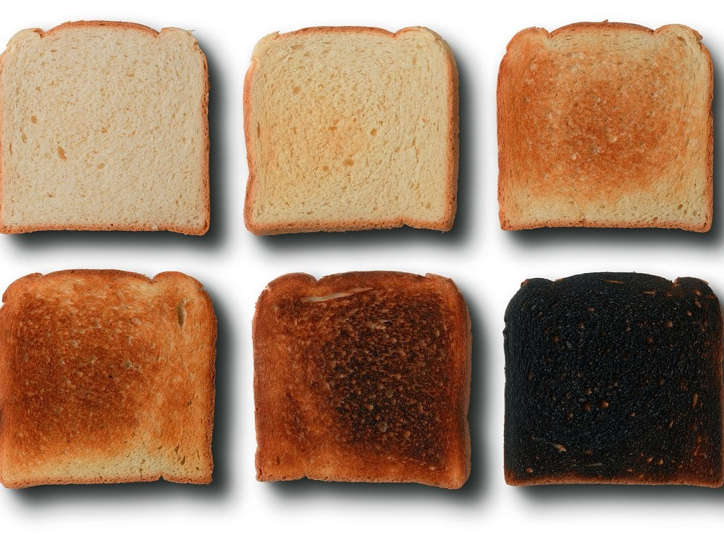

Flour, Water, Salt, Yeast…
The ingredients are the same, the Properties (taste, texture, density, etc) are different. These are set by the Processing.
Microstructure Matters!

Slide 3
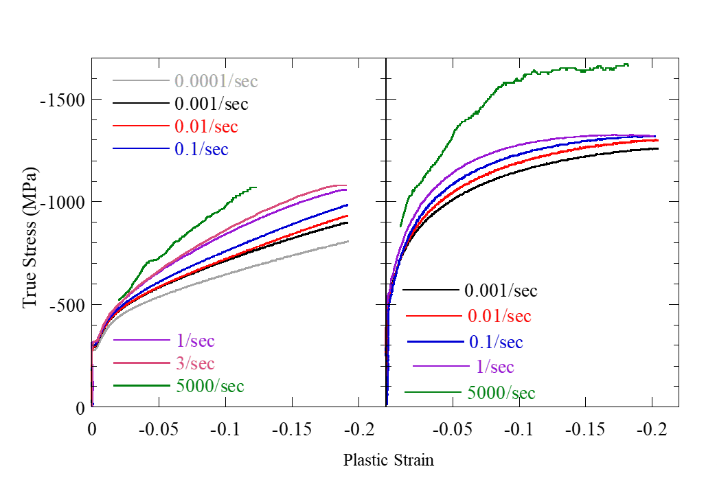
In Materials, We Call This The Process/Structure/Property Relationship.
Hot-Pressed Beryllium
Rolled (wrought) Beryllium

Slide 4
Bottom Line: Scattering Can Be Used to Quantitatively Determine Some Microstructural Features in Engineering Materials
Microstructural Feature | Property Effects | Accessible to Scattering? | Observable
Phase | Strength, Ductility | ✓ | Unique Diffraction Peaks
Texture | Elastic Modulus, Speed of Sound | ✓ | Peak Intensity
Defects/ Dislocations | Strength, Phase Stability | ✓ | Peak Width
Solute Distribution | Phase Stability, Strength | ✓ | Peak Shift
Residual Stress | Lifetime | ✓ | Peak Shift
Density Fluctuations (pores, phases, etc) | Mechanical Stability, Shock Propagation | ✓ | Increase in SAS
Grain Size | Strength |  | N/A
So far this is agnostic to Neutrons or HEXRD (>35keV keV).

Slide 5
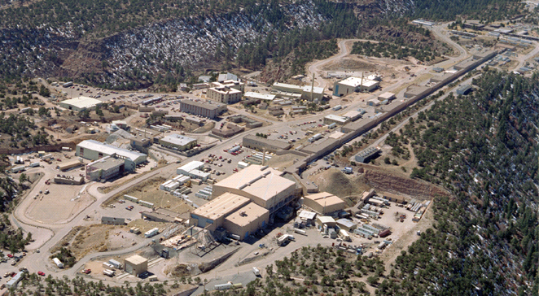
Los Alamos Neutron Science Center : LANSCE
Lujan Neutron Scattering Center
Weapons Neutron Research
Facility
Isotope Production
Facility
Neutron sources do not sit on desktops
Proton Radiography
800 MeV Proton Linear Accelerator

Slide 6
Time of Flight Neutron Diffraction at a Spallation Source
30m
t=0
λ=2dsinθ
Tungsten Target
Water Moderator
Q⊥
Velocity (and λ) determined by the neutron time of flight.
Entire diffraction pattern collected with unique diffraction vector.
  Advantageous for anisotropic samples.

Slide 7
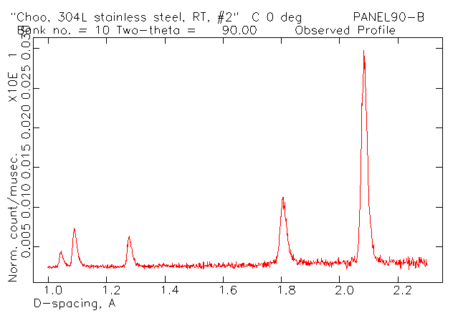
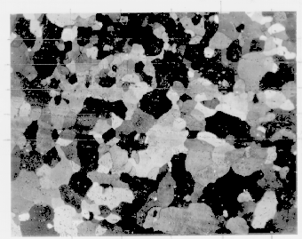
Diffraction Provides Non-Destructive Access to the Microstructure
(200)
Pos
Int
Width
(110)
Q
Diffraction naturally distinguishes between the response of different grain orientations (and phases).
Position : Stress, Temperature, Chemistry
Intensity : Texture, Phase Fraction, Disorder
Width : Size, Dislocation Density, …
Crystal anisotropy means grain response is orientation dependent.
Lattice parameter, a, averages over all orientations and best approximates macroscopic response.

Slide 8

Stress is Calculated From the Elastic Lattice Strain
d_{hkl}
We measure the spacing between atoms very accurately, ~10 ppm.
Calculate lattice strains from change in atomic spacing due to stress.
  Lattice strain :
If we know the spring constants, we can calculate the stresses from the strains.
$$ε_{lattice}=\frac{a−a_{0}}{a};{ ε}_{hkl}=\frac{d^{hkl}−d_{0}^{hkl}}{d_{0}^{hkl}}$$

Slide 9
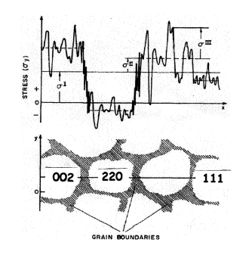
Diffraction Probes Stresses/Strains at Multiple Length Scales
Type III Intergranular Stress: peak width
Type I Macroscopic Stress: lattice parameter
Type II Intergranular Stress: d-spacing (hkl)
Elastic, plastic, thermal anisotropy, etc contribute to intergranular stress.
Dislocation density drives intragranular stress.
E. Macherauch: International Guidebook on Residual Stresses. (Pergamon Press, Elmsford, New York, 10523, 1987), p.^pp. 1-36.

Slide 10
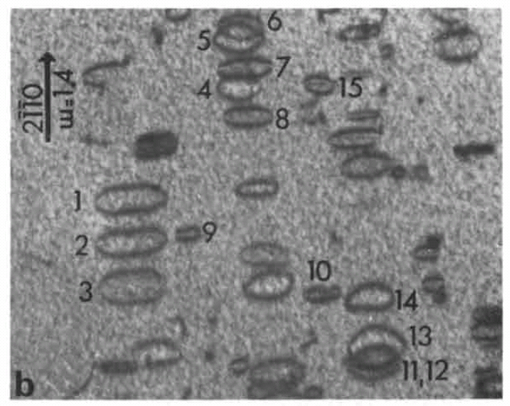
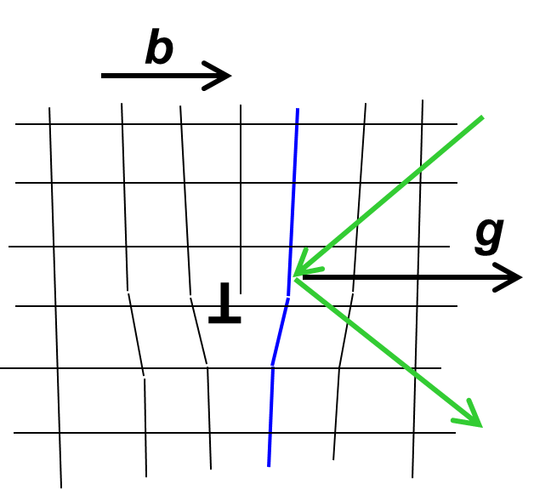
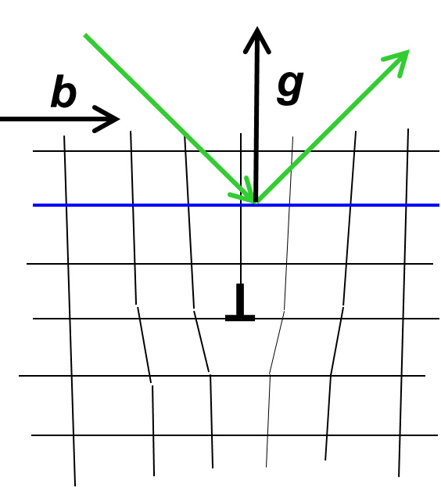
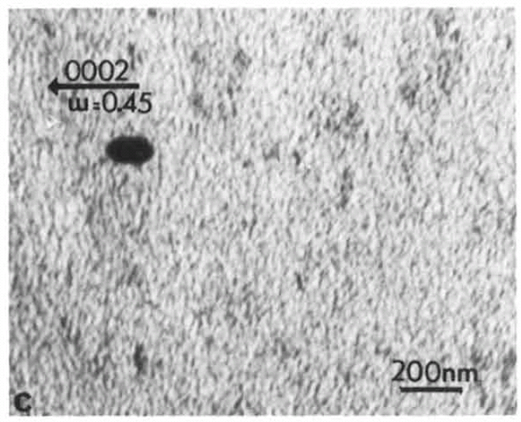
Stress Field Associated With Dislocations Results in Peak Broadening
g.b ≠ 0
g.b = 0
gb ≠ 0
gb = 0
dislocation is visible
strong contrast
dislocation is invisible
weak contrast
strong line broadening
weak line broadening
Jostsons, A., Kelly, P. M. and Blake, R. G., Journal of Nuclear Materials, 66 (1977) 236-256.

Slide 11
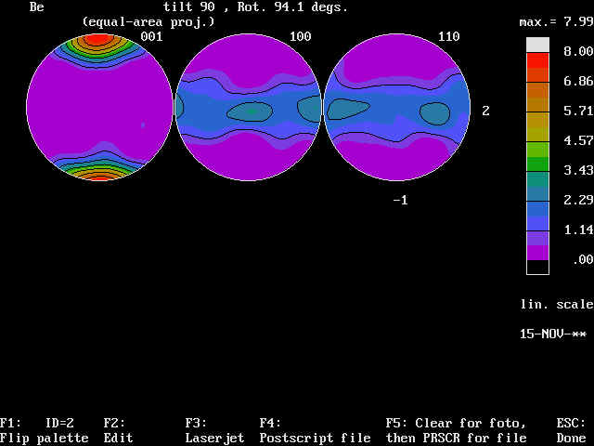
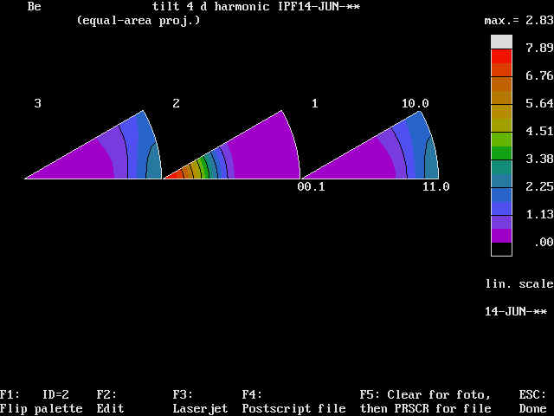
Representation of Crystallographic Texture : Pole Figures and Inverse Pole Figures
Rolling Normal
(002) Basal Pole
(100) Prism Pole
Rolling Normal
Rolling Direction
(110)
(002)
(100)
Pole Figure :Density of a given {hkl} as a function of orientation relative to sample axis.
  Measured directly with monochromatic x-ray or neutron diffraction.
Density of all {hkl}’s on stereographic triangle along a given sample axis.
  Measured directly with TOF neutron diffraction

Slide 12
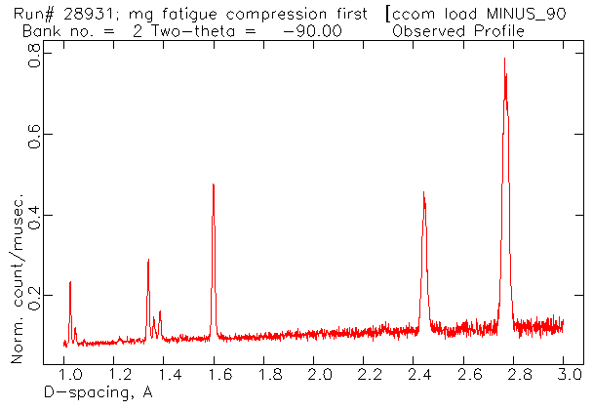
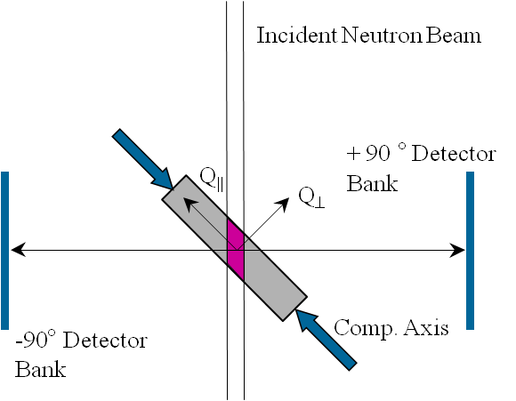
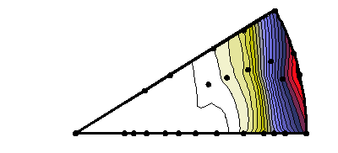
Peak Intensities Relate Directly to Crystallographic Texture
Rolled Magnesium
(100)
(110)
(210)
(002)
(110)
(210)
(002)
(100)
Rolling Direction
Notes:
19. The diffraction peak intensity is directly connected to the texture. Repeating from above, using the TOF technique with the fixed detector banks results in collection of the entire diffraction pattern simultaneously with collinear diffraction vectors. In other words, the entire diffraction pattern is collected from grains with poles along a single sample direction, say parallel to the straining direction of a compression sample. You will recognize that this corresponds directly to the definition of the inverse pole figure given above. Each peak intensity in the diffraction pattern can be mapped directly to the stereographic triangle for the material. If enough peaks are determined to allow contours to be drawn, then we can create the inverse pole figure from a single measurement. We can then watch the evolution of the crystallographic texture during deformation by monitoring the inverse pole figure while straining. The texture evolution is directly related to the active deformation mechanisms and may allow us to identify that deformation mechanism.
If we measure many inverse pole figures, say on HIPPO, then we can calculate the entire ODF and subsequently pole figures, if that is the preferred way to visualize the crystallographic texture.

Slide 13
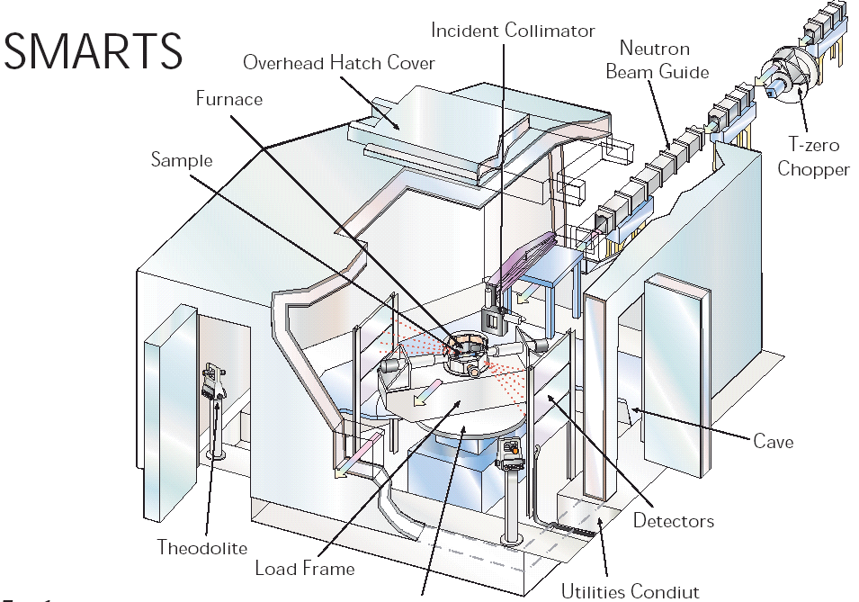
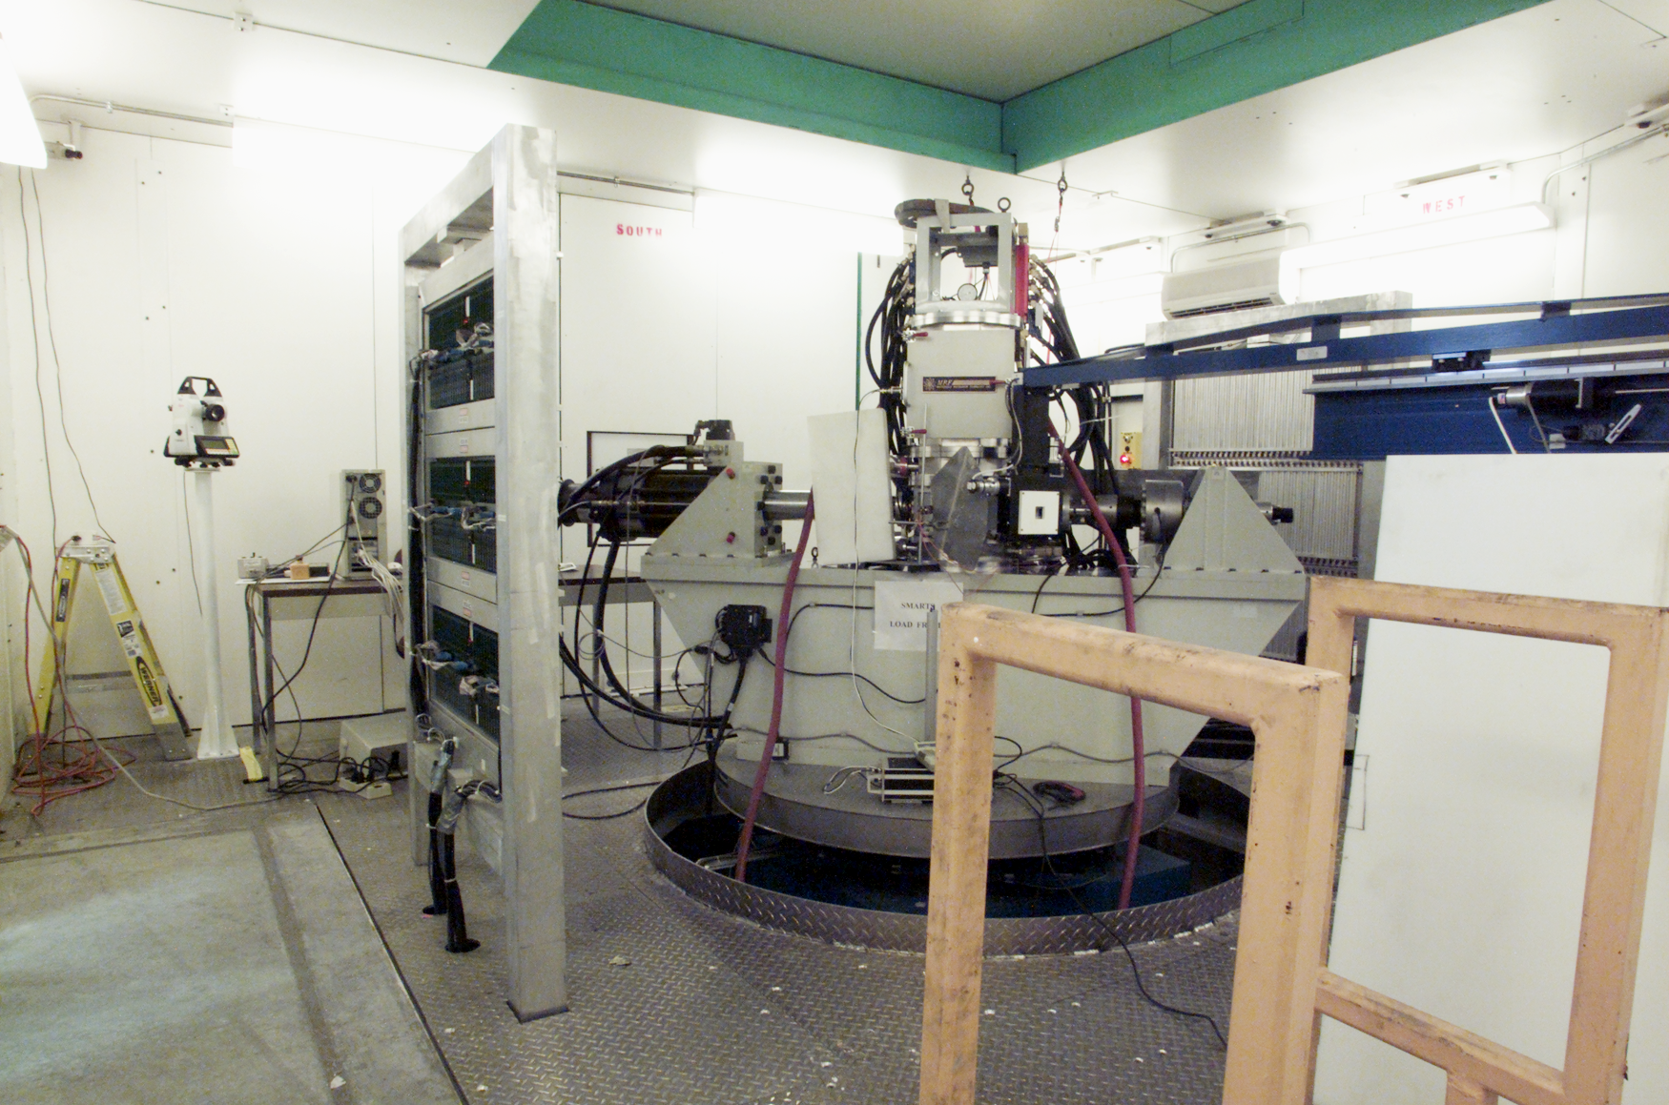
SMARTS Designed to Study Engineering Materials Under Operating Conditions
Translator
Moderately high resolution diffractometer.
  Can determine lattice strain to 1 part in 10⁵.
250 kN tension or compression, 100 kN T-C cycling.
90-2000K (1700K with loading).
Quenching furnace (>20C/sec).
Best spatial resolution of 1mm.
Sample table : horizontal travel ±30 cm, vertical ±60 cm, 370º rotation, 1500 Kg capacity.
Radioactive samples are easy.
~1 minute time scales, 1 mm length scales.
dbrown@lanl.gov

Slide 14
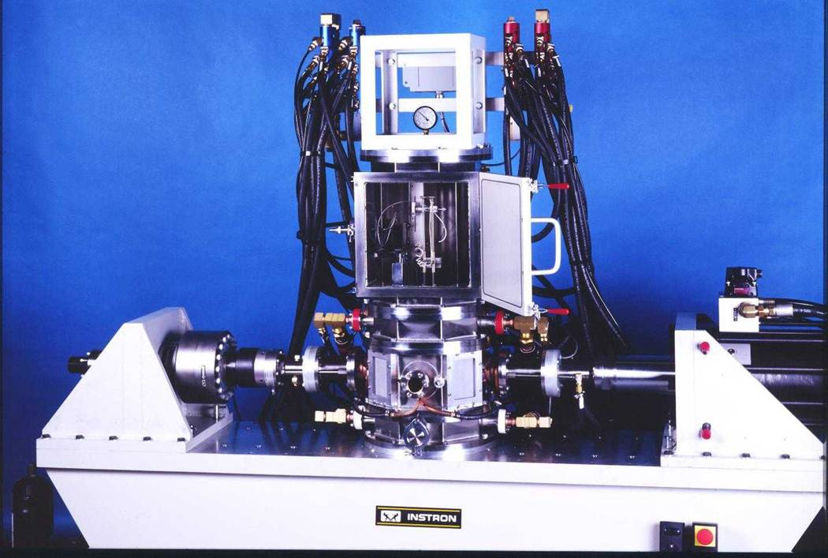
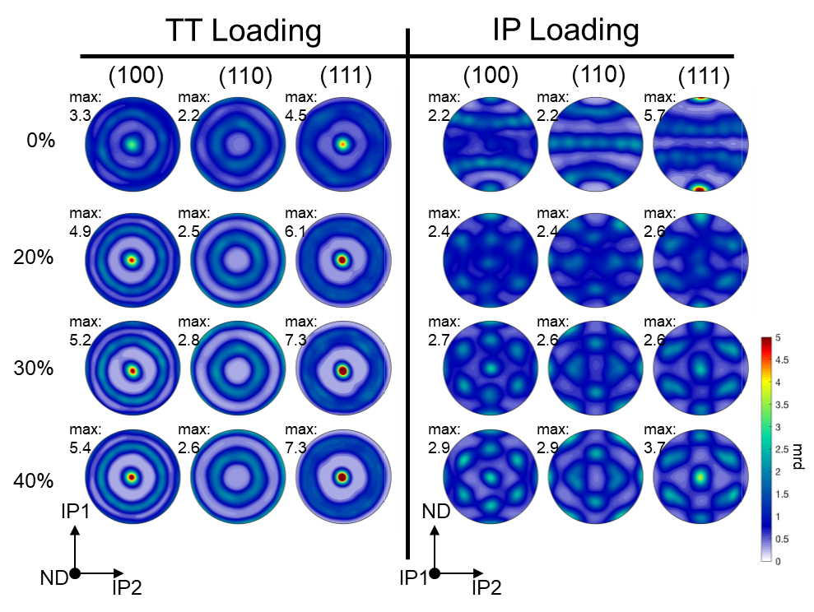
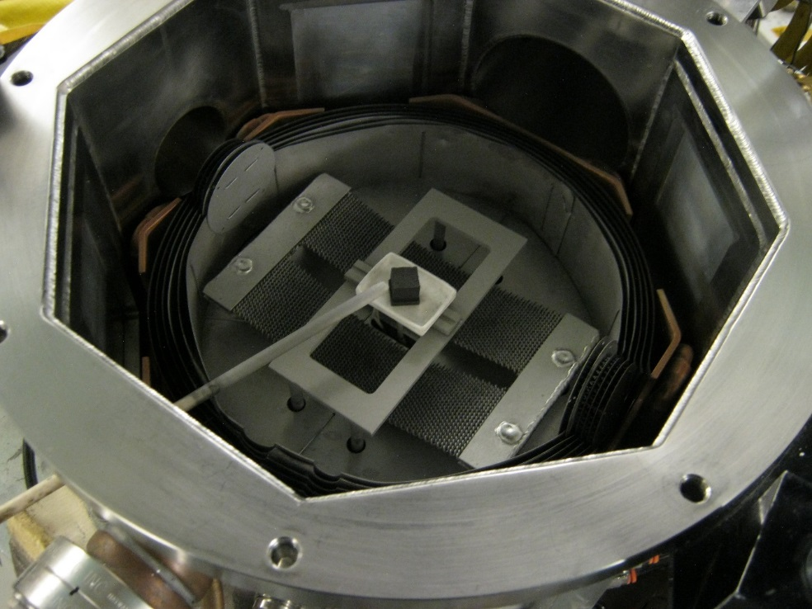
Sequential Deformation And Recovery Experiments on Tantalum Completed on SMARTS
High Resolution Detector Bank (3) (under incident beam)
Shielding
Q₂
Q₁
-90° Detector Bank (2)
Furnace
Double Containment
Sample
Rolled and annealed plate Tantalum
Grain size of roughly 35 μm
Samples from the through-thickness and in-plane directions
IP
TT
T.E. Buchheit, E.K. Cerreta, L. Diebler, S.-R. Chen, J.R. Michael (2014). Report SAND2014-17645. Sandia National Laboratory.
Notes:
17. Now, let us consider what diffraction tells us about the microstructure. Let’s assume that the we can identify specific grain orientations in the micrographs shown, those indicated in red have their (111) plane normals aligned as indicated by the red arrow, those in blue their (002). If we set up the diffraction geometry such that the diffraction vector is parallel to this common direction, then these grains will uniquely contribute to the (111) and (002) peaks indicated in the diffraction pattern. Now, diffraction differentiates between orientations (hkl’s) by the interatomic spacing (or d-space). Thus, the (111) diffraction peak specifically yields information about the subset of grains whose (111) plane normals are parallel to the diffraction vector, and likewise the (002) peak. By monitoring the response of these distinct peaks, one monitors the response of each of these specific grain sets independently. During an in-situ straining measurement, one typically aligns the diffraction vector with the straining direction or the transverse (Poisson’s) direction, and thus monitors grains with a specific crystal orientation with respect to the straining direction. It is obvious that this same technique may be used to monitor distinct phases in a composite as well. We will find that this is an incredibly powerful technique with which to study the deformation mechanisms of a material. Although it is beyond the scope of this talk, the output of this type of experiment can often be compared directly to model calculation to yield qualitative information about the activities of distinct deformation mechanisms in a material.

Slide 15
Sequential Deformation And Recovery Experiments on Ta Completed on SMARTS
In-Situ measurements limited to about 8% strain before buckling typically occurs.
Significant relaxation occurs while neutron data is collected.

Slide 16
Diffraction Measurements on SMARTS Reveal Stress Information at Multiple Length Scales
This spread represents the response to intergranular stresses, called anisotropy strain.
The strain from the lattice parameter (averaged over all grain orientations) is representative of the macroscopic strain.
Increase in peak breadth is indicative of intragranular strains and is linked to dislocation density

Slide 17
Ex-Situ Measurements Extend to Larger Strains
x In-Situ data
x In-Situ data
• Ex-Situ data
• Ex-Situ data
Intergranular Stress
Intragranular Stress
Dislocation Density

Slide 18
Dislocation Density Determined From the Diffraction Data

Slide 19
Recovery of Dislocations in Deformed Tantalum Initiates at 700K
Intergranular Stress
Intragranular Stress
Independent of the initial dislocation density (stored energy).

Slide 20
Recrystallization Manifests as a Texture Change at Higher Temperature
q dependent reduction in intensity is a response to the increase of the Debye-Waller factor
Occurs earlier with increased deformation
Orientation dependent intensity change is indicative of texture ramdomization
8% Strain
20% Strain
40% Strain

Slide 21
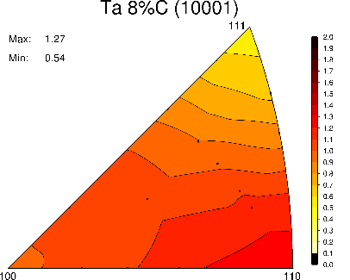
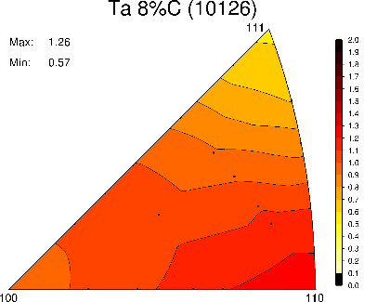
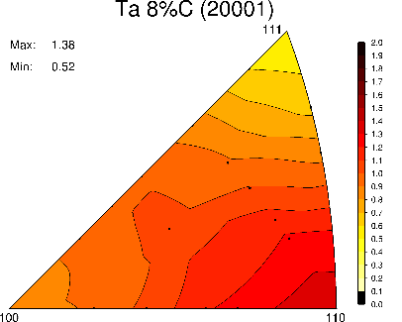
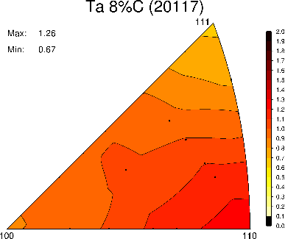
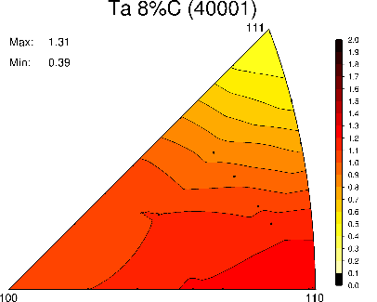
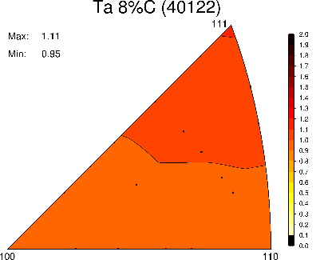
Increased Dislocation Density (Stored Energy) Drive RX at Lower Temperatures
8%
x
20%
∆
40%

Slide 22
Conclusions
Neutrons (and X-rays) provide a convenient, quantitative, non-contact probe of the microstructure.
  Phase, texture, stress, dislocation density, solute chemistry.
In careful measurements, can separate stresses by length scale.
The increase in dislocation density during deformation is easy to observe, but difficult to quantify.
Recovery and RX are observable as distinct events during heat treating
Study element Ta as a step toward complex BCC alloys.
This data can be used to develop predictive process/structure/property relationships and enable “materials by design”.

Slide 23
The Rate at Which Dislocations Decrease is Independent of the Initial Dislocation Density
The next steps are to develop the deformation and recovery models, and to get irradiated samples from Idaho National Laboratory

Slide 24
The Goal of the Materials Scattering Team is to Provide Experimental Support of Model Development Across the PSPP Relationship
Phase
Defects
Texture
Internal Stress
Chemistry
High Energy X-ray and Neutron Diffraction/Imaging
Advanced models are critical for science-based qualification.
  Models and data must bridge length and time scales.
  Quantitative microstructural data is necessary.

